Slide 1
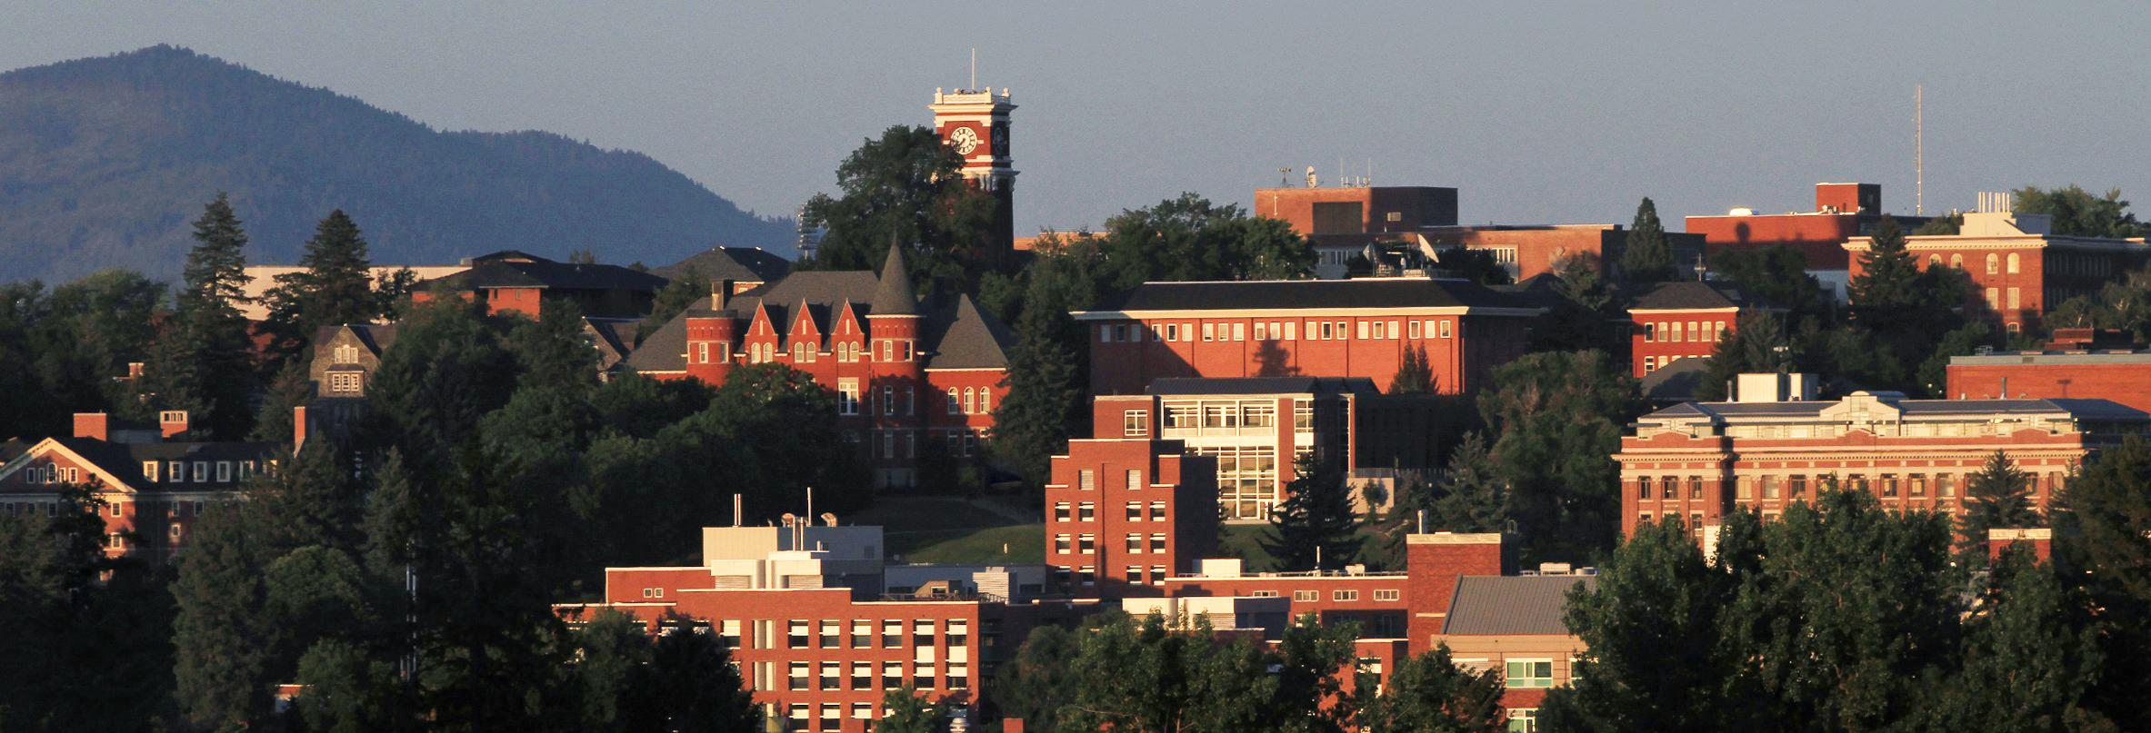
Application for GCCM Recertification
Capital Projects Advisory Review Board
Project Review Committee
May 2019

Slide 2
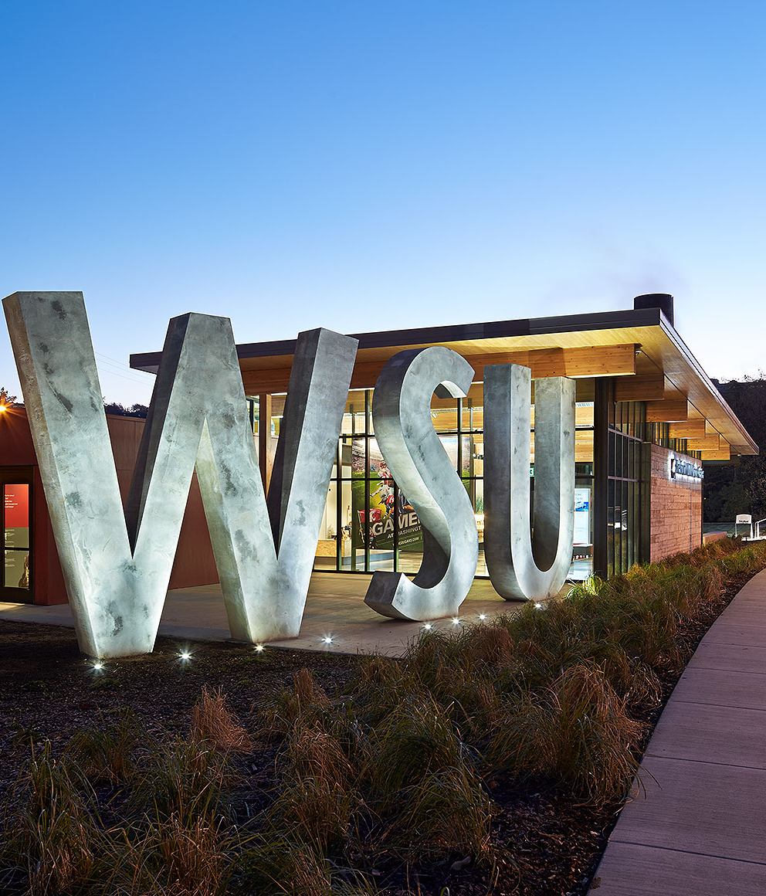
Introductions
Olivia Yang
Associate Vice President – Facilities
Joe Kline
Assistant Vice President – Capital
Louise Sweeney
Lead Project Manager
Mike LaVielle
Lead Construction Manager
Maja Huff
Contracts Manager

Slide 3
Washington State University
Land Grant, Research University
Five Campuses
Pullman 1,742 acres, over 12M sq. ft.
Spokane 40 acres
Tri-Cities 202 acres
Vancouver 351 acres
Everett 5 acres
Research and Extension Centers
Prosser, Puyallup, Wenatchee and Mt. Vernon
$150M - $300M in our capital project portfolio

Slide 4
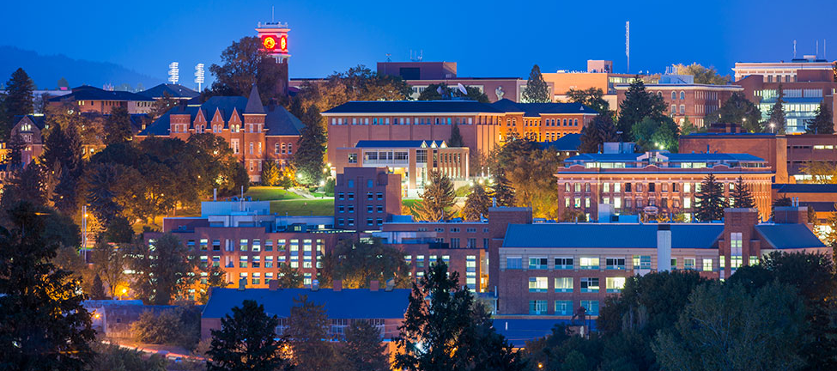
Washington State University Facilities Services
Associate Vice President for Facilities Services
Operations
385 employees
Finance & Administration
15 employees
Capital
19 employees
FIRM
6 employees

Slide 5
Project Delivery Organization Chart

Slide 6
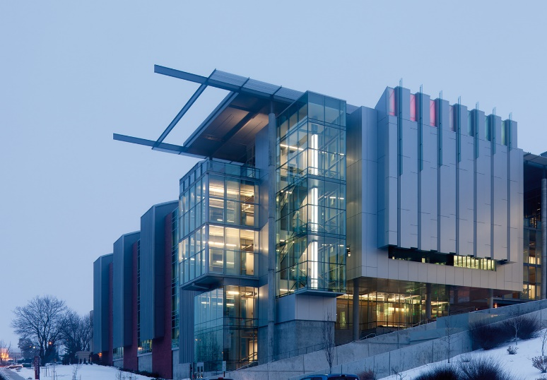
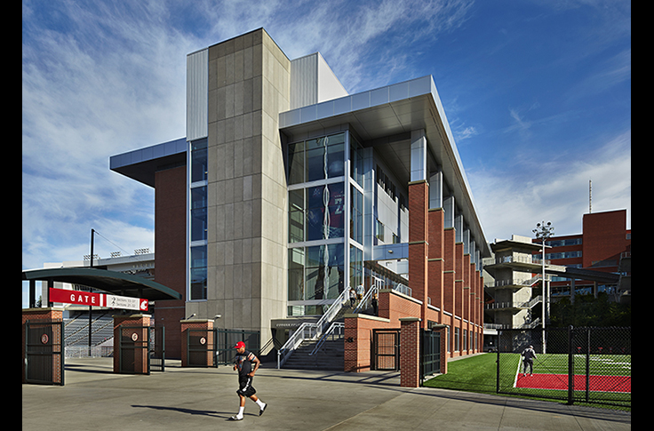
What We Have Done
GC/CM Project
Veterinary Medical Research Building (REC 4)
Project Budget $96M
GCCM Contract $61.9M Lydig
Design SRG
Completion September 2015
Observation
Neuroscience / Biomedical Laboratory Building
GC/CM Project
Martin Stadium Football Operations
Project Budget $61M
GC/CM Contract $50M Hoffman
Design ALSC
Completion May 2014
Observation
Athletics/Training Facility

Slide 7
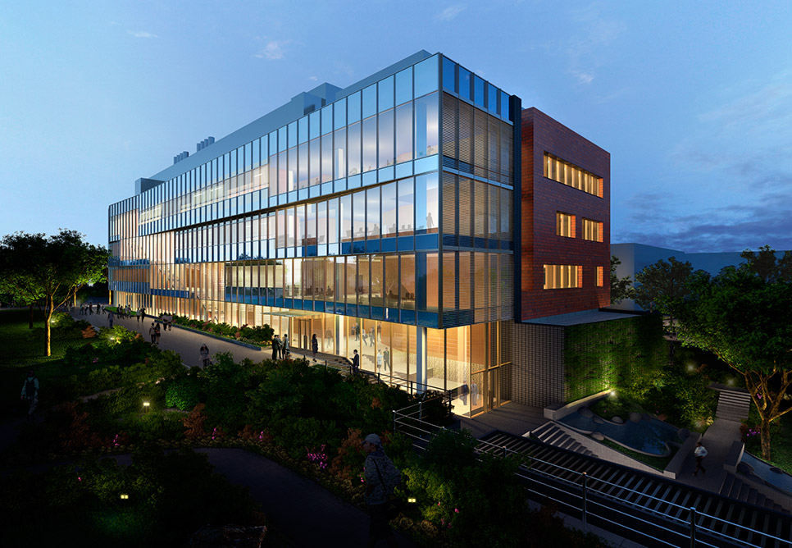
What We Have Done
GC/CM Project
Spokane Biomedical and Health Sciences Building
Project Budget $80M
GC/CM Contract $57M Graham
Design NBBJ
Completion November ‘13
Observation
Biomedical, Pharmacy, Laboratory Building

Slide 8
Why WSU is Ready to be Recertified
Commitment to process improvement
WSU PM/CM’s attend and have taught as part of AGC’s GC/CM training program.
Participation on CPARB and subcommittees
Contract Review (Perkins Coie)
Review and rewrite of DB and GCCM completed in 2015.
Ongoing PM/CM External and Internal Training
Active in DBIA, CMAA, AIA, other trade organizations
Ongoing internal training
This year’s will focus on qualifications based selection processes.

Slide 9
Facilities Services Capital Staff
10 Project Managers
4 with GCCM Experience
3 Construction Managers
2 with GCCM Experience
6 Engineering Group
Credentials include:
Registered Architect
PE’s – Civil, Structural, Mechanical
Interior Design Certified – NCIDQ
Subject Matter Experts - MEP

Slide 10
Accreditations
5 DBIA Professionals/Associates
4 LEED AP’s
1 CCM
Continuing Education Opportunities
Internal Training
DBIA conferences and Lunch & Learns
SCUP, Tradeline, AIA, AUID, Peers and Trade Partners
Presentations/ Panel Discussions
SCUP, Tradeline, DBIA, AIA, CMAA, AGC
Collaborate w/ WSU Voiland College of Engineering & Architecture
State of Washington Public Owners Group

Slide 11
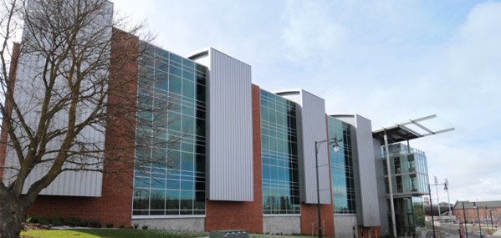
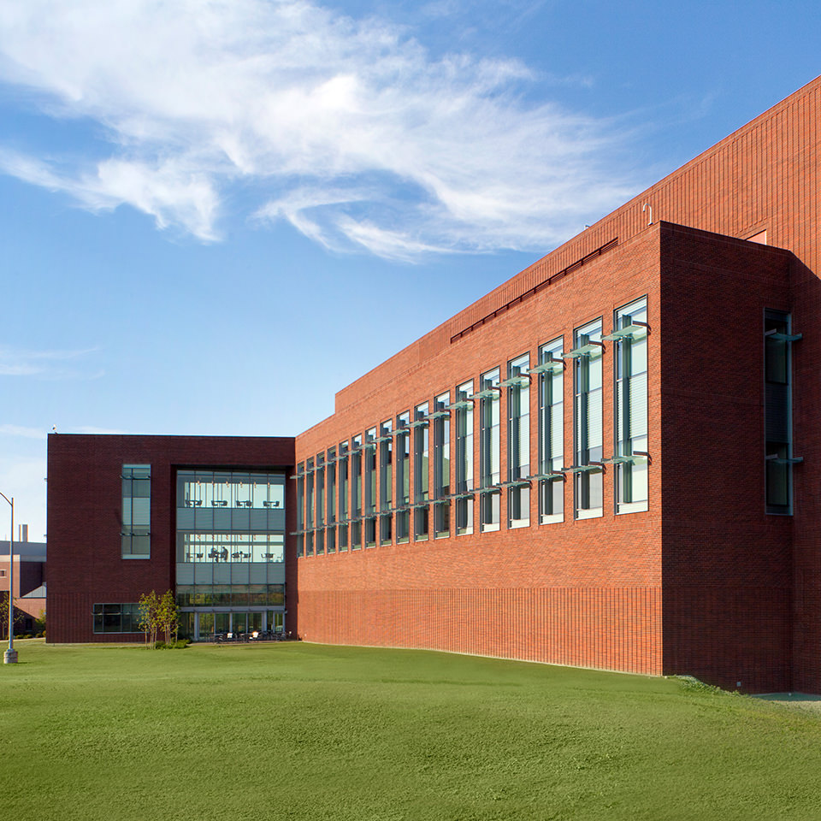
Project Awards
Veterinary Medical
Research Building –
AIA Washington Council, Merit Award, 2013
Global Animal Health
Phase 1 –
Excellence in Masonry Award, 2013

Slide 12
Training
Developed and trained 45 discrete PM/CM training topics since last certification.
Continue to develop and provide recurring training for Capital staff with specialized on-boarding training for all new employees.
Training areas include Source-Selection, Pre-Design/Design & Construction Administration, Close-out, Disputes, Impacts, Cost & Time Changes, Funding & Contract Types, Risk Analysis and Negotiations, Contractor Performance Evaluations
CM/PM Training Big “Take-aways”
Standardization across PM/CM Team
Improved Schedule and Cost Analysis for Contracts and Changes
PM/CM Roles and Responsibilities
Risk Analysis and Sharing

Slide 13
Contracting
Legal Counsel
Nathan Deen, Assistant Attorney General
Perkins Coie LLP, Dick Prentke and Andrew Greene
Contract Documents Overhaul
Express goal to be fair, reasonable and consistent across all forms of Public Works
Implemented continual contract review
During this certification period
Change Orders and Dispute Resolution
Simplified pricing for changes, and responsive informal dispute resolution process.
Post Completion Performance Period
Transition to Substantial Occupancy

Slide 14
In Summary : WSU is Ready to be Recertified
History of Alternative Procurement Success
Demonstrated Success on a Wide Variety of Project Types
Well Qualified and Experienced Team of Project Managers and Construction Managers

Slide 15
Questions

