Slide 1

Snohomish County Sheriff’s Office South Precinct
Application to Use General Contractor/Construction Manager
Project Review Committee Meeting: September 26th, 2019
Notes:
Jeff: 1 Minute

Slide 2

Agenda
    Introductions and Organization Chart
    Project Description
    Why GC/CM
    Public Benefit
    Budget and Funding
    Schedule
    Project Management and Qualifications
    Questions
Notes:
Jeff: 1 minute

Slide 3
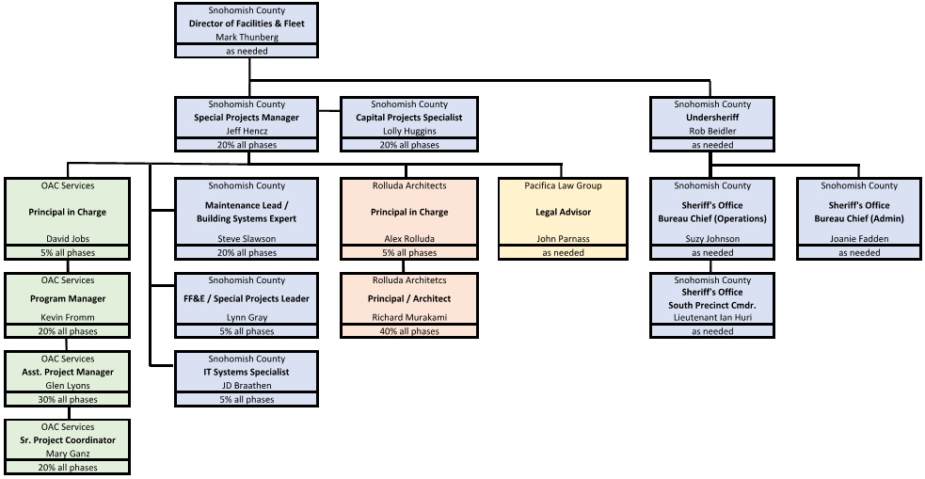
Introduction – Organization Chart
Notes:
Jeff 3 Minute

Slide 4
Project Description - Scope
Construction of a replacement South Precinct for the Snohomish County Sheriff’s Office, a two-story essential facility, the current facility is a leased building in Mill Creek.
  Located on County-owned land near existing County facilities.
  New building will house, local administration and command, investigative, criminal analysis, and special operations, local patrol division, secure holding, evidence storage and support functions, public elements – lobby, front counter, meeting and training rooms, and conference / collaboration rooms
Proposed facility location provides benefits critical to service delivery
  An exhaustive location search was done, and the department overwhelmingly arrived at this location
Complexities in the site and the design create challenges for the project but are solutions and beneficial to the Sheriff’s department.
Notes:
Chief Joanie and Captain Flood 4 Minutes

Slide 5
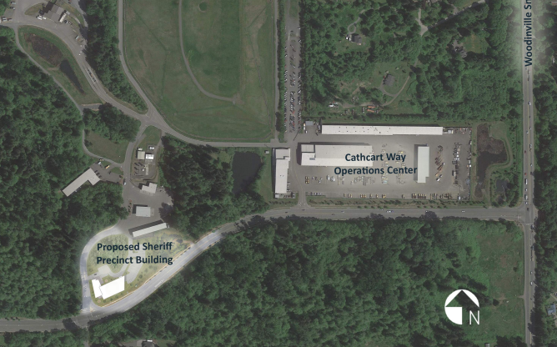
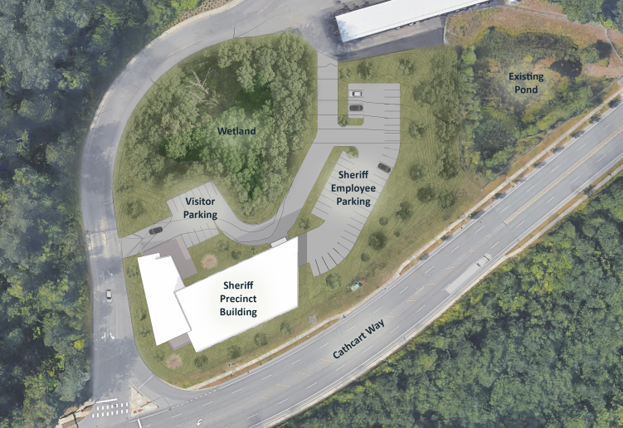
Existing Facilities(must remain operational at all times)
Notes:
Rich 1 Minute

Slide 6
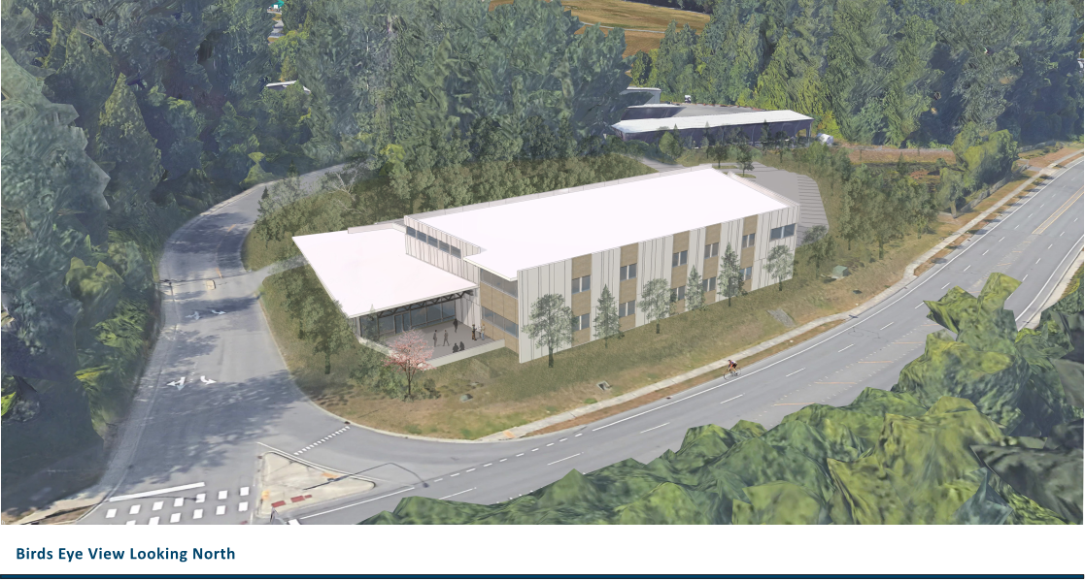
Notes:
Rich 1 Minute

Slide 7
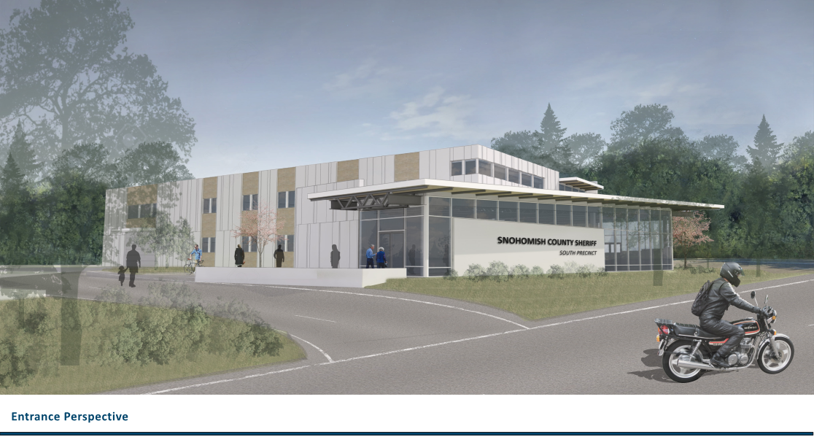
Notes:
Rich 1 Minute

Slide 8
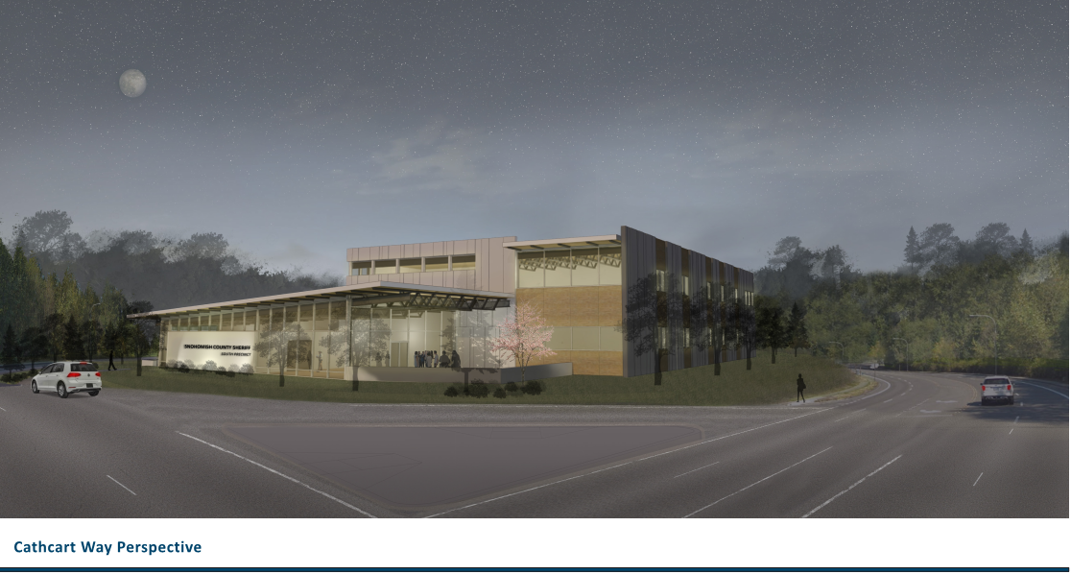
Notes:
Rich 1 Minute

Slide 9
Why GC/CM is Appropriate
Complex Phasing and Scheduling
  Sheriff’s Office must open the new facility by August 2021.
  This calls for phased permitting and careful staging.
Construction at an Existing Facility
  Adjacent County facilities must remain operational and unimpeded at all times.
GC/CM involvement is critical during the design phase
  GC/CM’s perspective is valuable to ensuring design meets budget and schedule constraints.
  Complexity of security and access control systems call for GC/CM input during design.
The project involves complex and technical work
  Early GC/CM involvement mitigates risks from logistical and security challenges.
  GC/CM’s understanding of those challenges and risks is crucial to design phase, subcontractor procurement, and construction.
Notes:
Dave 2 Minute

Slide 10
Public Benefit
  Increased cost and schedule predictability.
  By engaging the contractor early and building an integrated design and construction team to support decision making, accurate estimating, and staged buyout, overall predictability of delivery is increased, and the risk of over-budget bidding is reduced.
More attractive to the highly qualified contractors in the region than a design-bid-build project.
  A project of this complexity is biddable by fewer of the region’s general contractors, many of whom would be unlikely to bid the project in a design-bid-build delivery model. The GCCM delivery will attract more competition and result in lower cost and greater value to the taxpayers.
Planning, coordinating and executing complex building systems is best done with collaboration between designers and builders.
  GCCM construction supports close collaboration during design, buyout, and construction and the use of modern technologies including Building Information Modeling, Virtual Design and Construction and early award of scopes of work with long lead times and/or are weather sensitive.
Notes:
Dave 2 Minutes

Slide 11
Funding - Budget
Budget
Costs for Professional Services (A/E, Legal Etc.) | $840,000
Estimated project construction costs (including construction contingencies): | $10,500,000
Equipment and furnishing costs | $400,000
Off-site costs (Temp. facilities, utilities.) | $175,000
Contract administration costs (Owner, Construction Manager, etc.) | $485,000
Contingencies (Owner) | $635,000
Sales Tax | $945,000
Total | $13,980,000
Available Funding (Bonds, General Fund, Department of Commerce Grant) | $13,980,000
Notes:
Kevin 1 Minute

Slide 12
Procurement Schedule
Notes:
Kevin 1 Minute

Slide 13
Project Management
Notes:
Kevin 1 Minute

Slide 14







Thank You / Questions
PRC Panel
Kurt Boyd
Panel Chair
Ato Apiafi
Panel
Thomas Golden
Panel
Brian Holecek
Panel
Dave Johnson
Panel
Jessica Murphy
Panel
Jason Nakamura
Panel
Linneth Riley-Hall
Panel
Project Team
Joanie Fadden,
Snohomish County Sheriff, Bureau Chief
John Flood,
Snohomish County Sheriff, Captain
Mark Thunberg,
Snohomish County, Director
Jeff Hencz,
Snohomish County, Project Manager
Rich Murakami,
Rolluda Architects,
Principal
Kevin Fromm,
OAC,
Program Manager
Dave Jobs,
OAC,
Vice President
Notes:
Kevin to field questions with support by all

