Slide 1
GRANT PUD Load Growth Project
Application for Project Approval Using Design-Build, 6/27/2019
Russ Seiler, Grant PUD
Mike Muhlenhaupt, Stanley Consultants
Stanley Consultants

Slide 2
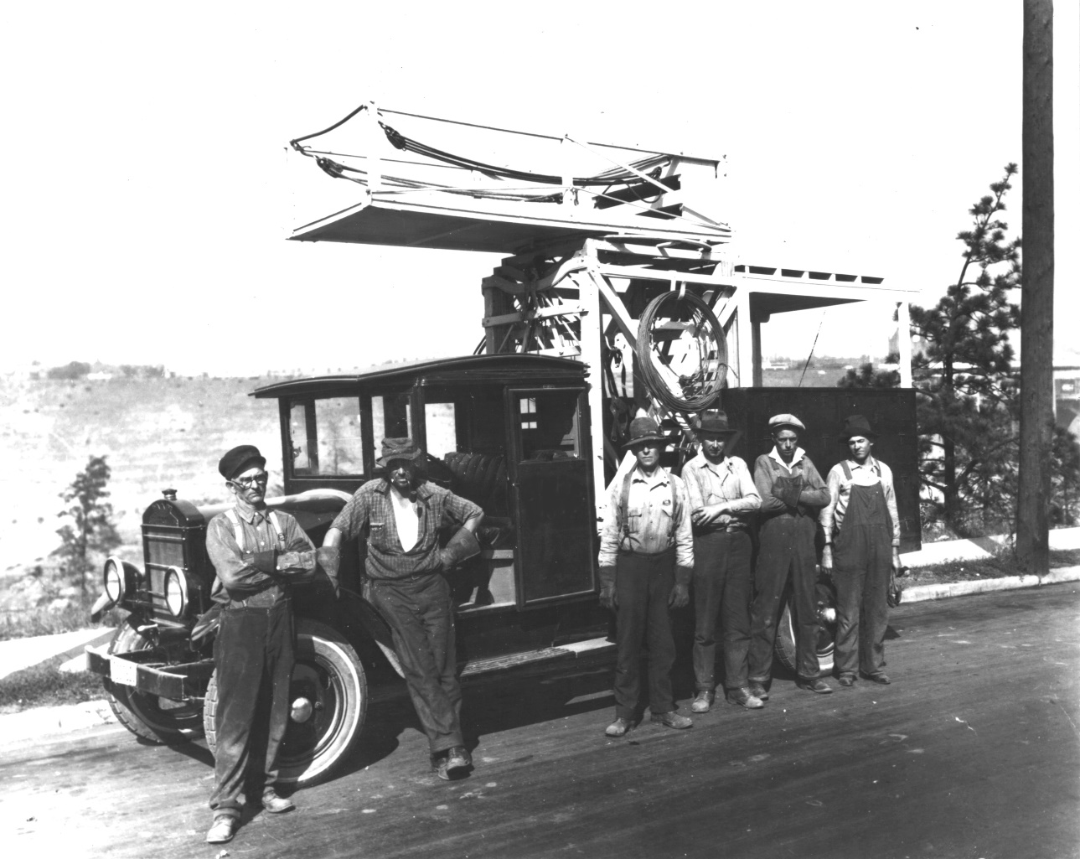
Who We Are
Public Utility District No. 2
Grant County, WA (Grant PUD)
Created in 1938 by Grant County Voters
Serve approximately 100,000 customers

Slide 3
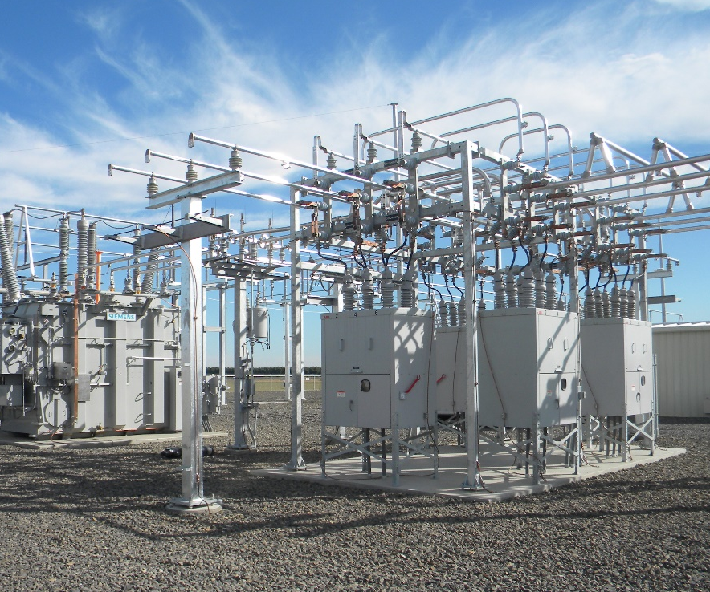
Why We Are Here
Growing Region & Customer Base
Ongoing Demand for Increased Power
5 Plus Year Backlog
Traditional Delivery ~ 2 Substations / Year
Unable to keep pace with demand.
D-B-B = 2024 Project Completion
D-B = 2022 Project Completion
OUR MISSION
To efficiently and reliably generate and deliver energy to our customers.

Slide 4
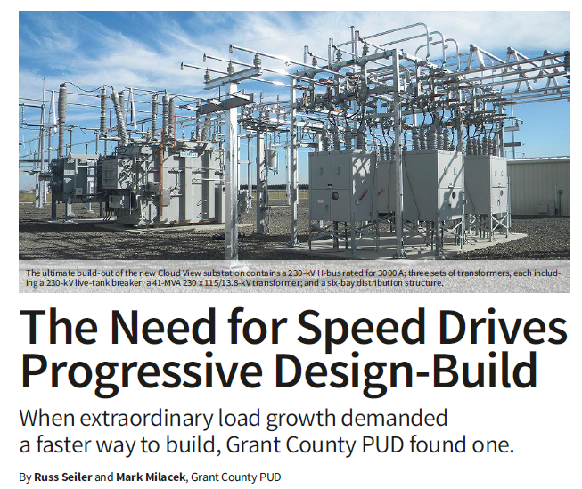
Design-Build Experience
Completed First Progressive Design-Build in 2017
8 Substation Sites Constructed in 18 Mo.
DBIA Merit Award
Featured in T&D World
Formal Lessons Learned Process
David Gunderson and Rick Cherf (WSU)

Slide 5
Team Structure
ROBYNNE THAXTON, JD, FDBIA
Thaxton Parkinson, PLLC
D-B Legal Counsel
SCOTT TOMLINSON, CCM
VANIR Construction
Management
MITCH DELEBARRE
Legal Counsel
JEFF GRIZZEL
Managing Director
Project Sponsor
POWER DELIVERY
On Call
RUSS SEILER, PE, PMP
Manager of Power
Delivery Projects
DAVID KLINKENBERG
Project Manager
CHRIS JOHNSON, PE
Substation Engineer
RANDY KONO, PE
Transmission Engineer
SHEILA WALD
Project Coordinator
GREG CARDWELL
Construction Manager
STANLEY CONSULTANTS
MIKE MUHLENHAUPT, PE
Engineering Project Manager
CHRIS STOOPS, PMP
Project Controls Specialist
JEFF ROBERTUS, PE
Sr. Substation Engineer
MATT GRYLICKI, PE
Sr. Transmission Engineer

Slide 6
Team Experience
SCOTT TOMLINSON, CCM
VANIR Construction
Management
Robynne Thaxton, 18 DB Projects
Scott Tomlinson, 3 DB Projects
Russ Seiler, 1 DB Project
Chris Johnson, 1 DB Project
Mike Muhlenhaupt, 7 DB Projects
Chris Stoops, 4 DB Projects
Jeff Robertus, 5 DB Projects
Matt Grylicki, 6 DB Projects

Slide 7
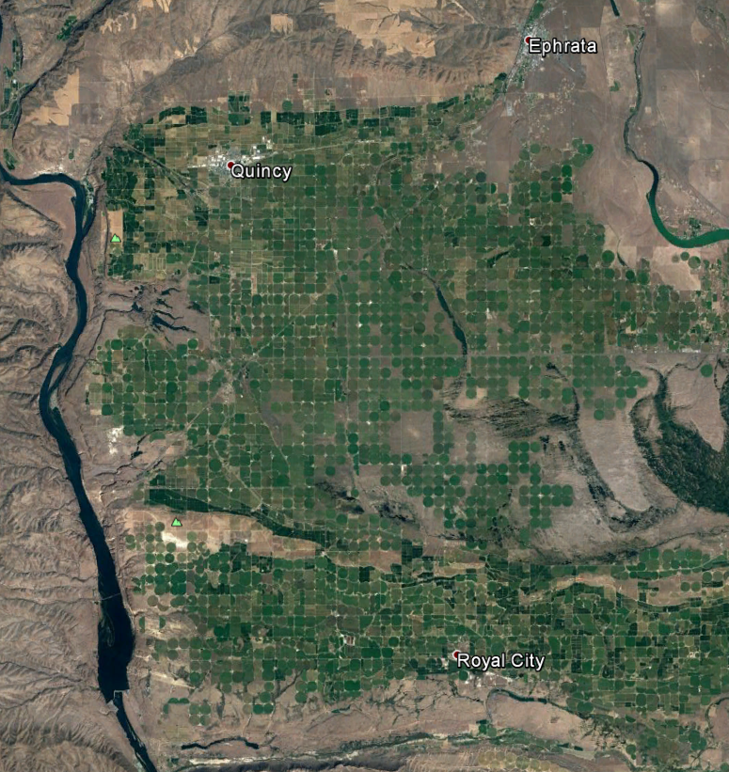
The Project
Base Scope
Red Rock Substation
Red Rock Transmission Line (Not Mapped)
Burke Substation
230kV Capacitor Bank
South Ephrata Substation
South Ephrata Ring Bus
Royal City Substation
Quincy Plains Substation
Alternate Scope
Cyprus Substation
Monument Hill Switchyard
Monument Hill Transmission Line
Quincy Substation
South County Substation

Slide 8
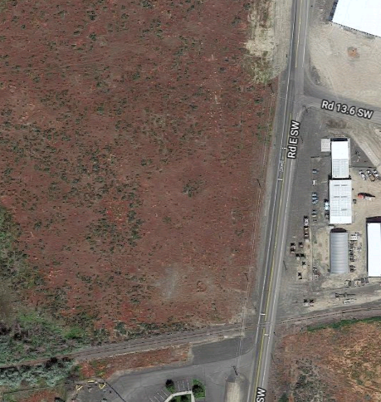
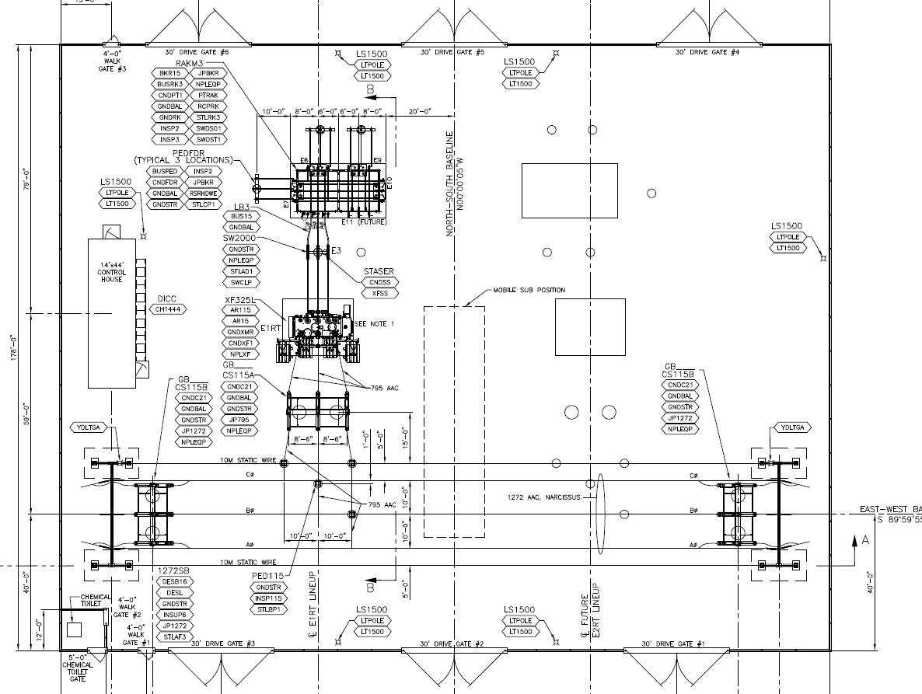
THE PROJECT Red Rock Substation
Scope:
New Substation
Enable Load Growth
in Port of Royal City

Slide 9
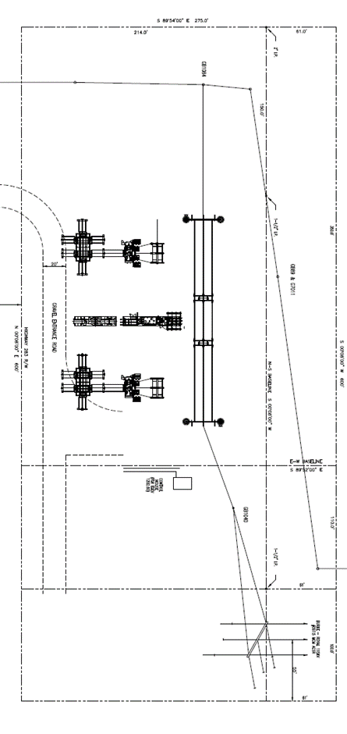
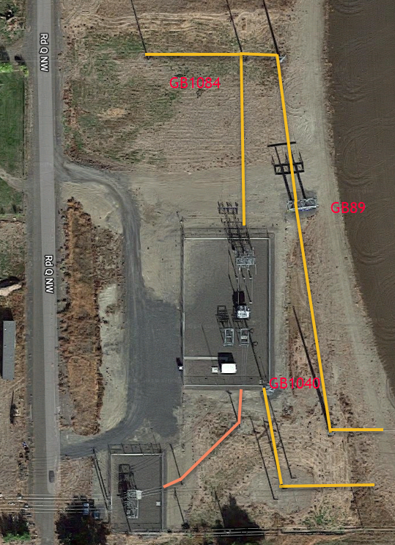
THE PROJECT Burke Substation
Scope:
Rebuild / Expand
1950’s Substation
Serve More Customers
Increase reliability

Slide 10
Why Design-Build?
Primary Drivers:
Two Year Reduction in Schedule vs. D-B-B!
Repeat Past Success in Progressive Design-Build
Early DB Involvement to Assist in Determining Project Scope
Other Factors:
Limited Staff at Grant PUD
Early Contractor Involvement Leads to Innovation
Multiple Sites with One Consistent Team Enhances Quality and Efficiency

Slide 11
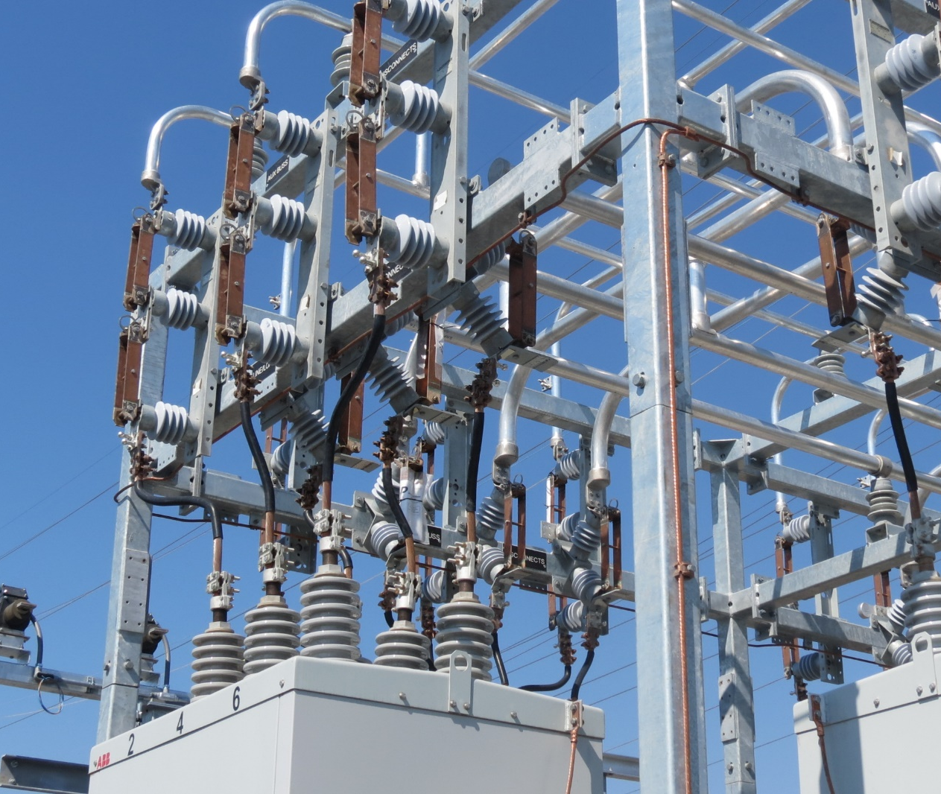
Lessons Learned From DB1
Keys to Success
Trust and Communication
Clear Initial Basis of Design
Owner Involvement
Internal Inspector QA Roles
DB Performance Incentives

Slide 12
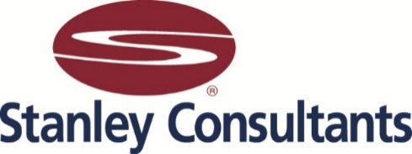
Questions?

