Slide 1
GC/CM Delivery Approval Request
Tukwila Justice Center Project
November 30, 2017

Slide 2
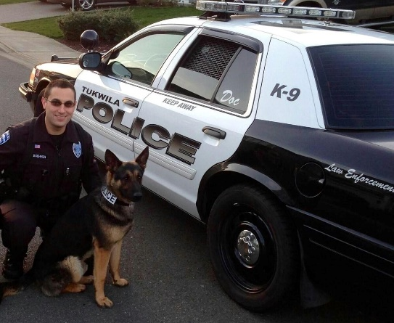
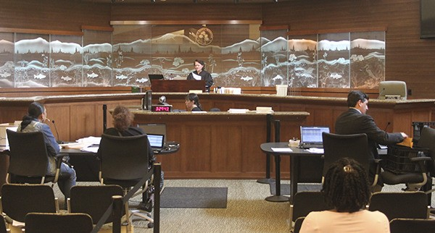
PROJECT TEAM
David Cline
City Administrator, City of Tukwila
Rachel Bianchi
Public Safety Plan Manager, City of Tukwila
Justine Kim
Program Manager/Sr. PM, Shiels Obletz Johnsen
Ethan Bernau
Project Manager, Shiels Obletz Johnsen
Bill Valdez
Principal, DLR Group
Erica Loynd
Project Manager, DLR Group
Steve Goldblatt
Program Management Quality Assurance Consultant,
Tukwila City Council

Slide 3
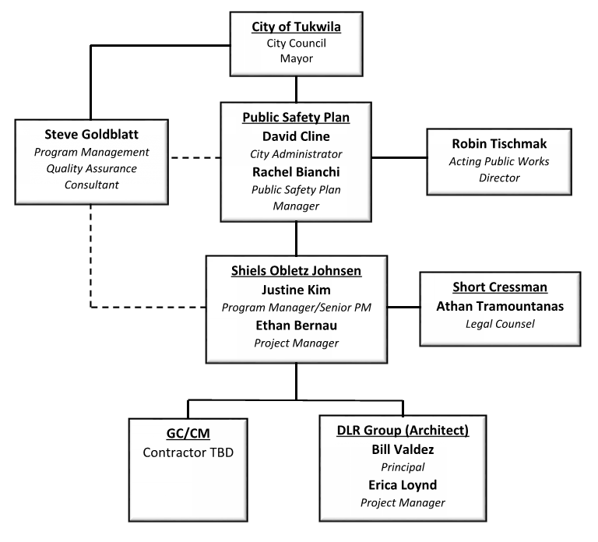
PROJECT ORGANIZATION

Slide 4
PROJECT DESCRIPTION
Description
The new Justice Center is an approximately 45,500 SF building that will house the Police Department and Municipal Court. It will also include an Emergency Operations Center (EOC) for the City.
The site acquisition process is underway, with a site identified on Tukwila International Boulevard, based on site selection criteria approved by the City Council.
Police Department
Approx. 30,000 SF police station will house police administration, patrol, investigations, special operations, SWAT, K-9, records, evidence, holding and support spaces. The facility will also include a vehicular sallyport and secured parking for staff, including police vehicles.
Municipal Court
Approx. 9,500 SF municipal court will house court administration, courtroom, jury room, hearings room, probation, in-custody/holding and support spaces. The facility will also include secured parking for staff.
Emergency Operations Center
Approx. 6,000 SF EOC will be housed in a multi-purpose conference center shared by police and courts.

Slide 5
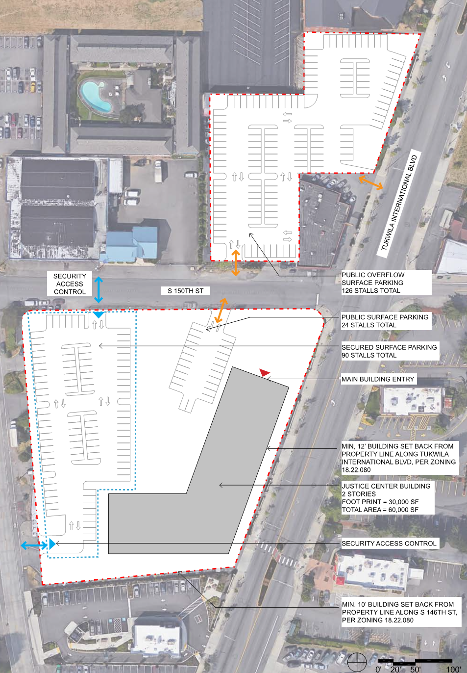
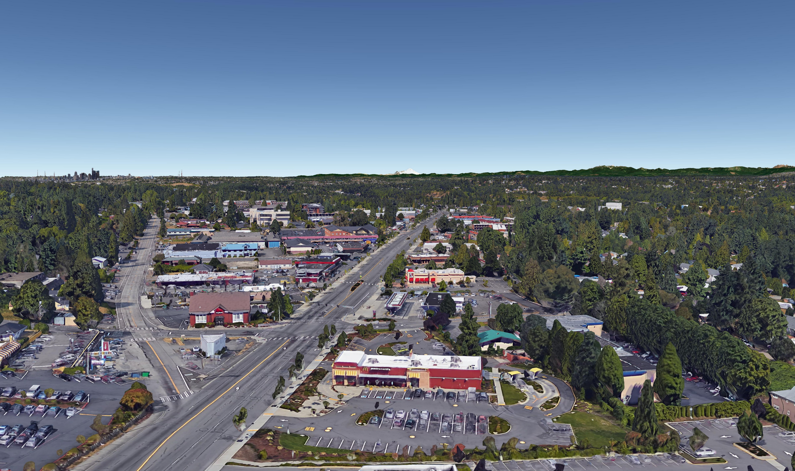
CONCEPTUAL SITE PLAN
Tukwila International Boulevard

Slide 6
PROJECT BUDGET
Costs for Professional Services (A/E, legal, etc.) $1,616,000
Estimated project construction costs (incl. construction contingencies) $16,195,000
Equipment and furnishing costs $478,000
Off-site costs/site acquisition $6,000,000 Contract administration costs (owner, PM/CM, etc.) $1,114,000
Contingencies (design & owner) $2,200,000
Other related project costs (permits, survey, geotech) $1,026,000
Sales tax included
TOTAL $28,629,000

Slide 7
GC/CM DELIVERY
Why GC/CM for Tukwila’s Justice Center
Scheduling
Current facilities are overcrowded, seismically deficient and vulnerable to disasters, lack modern security features, and need to be replaced as quickly as possible.
GC/CM will help identify and mitigate project risk factors that could delay project delivery, such as volatile cost escalation, materials and labor shortages, environmental remediation, etc.
Schedule may require phased construction to address demolition, building hazardous materials or site environmental remediation.
GC/CM will help schedule and streamline the subcontractor buyout and construction process.

Slide 8
GC/CM DELIVERY
Why GC/CM for Tukwila’s Justice Center
Complex Systems
Police, Court and EOC facilities include specialized security, detention, mechanical, electrical and communications that are unique and critical to uninterrupted operations.
GC/CM will help ensure highly experienced and well qualified specialty subcontractors are attracted to the project and will provide quality control.
Technical Work Environment
Sites on Tukwila International Boulevard are likely to have environmental cleanup risks, due to history of industrial and auto-oriented uses.
GC/CM can help investigate underground conditions, develop schedule contingencies, and minimize unforeseen conditions that could delay construction and drive up change order costs.

Slide 9
GC/CM DELIVERY
Involvement of GC/CM During Design is Critical
GC/CM can vet design assumptions, provide value analysis and eliminate unnecessarily costly solutions, provide design document quality control, and minimize constructability issues.
GC/CM can monitor construction costs in real-time for each design phase and respond accordingly.
GC/CM can tailor bid packages to attract multiple qualified bidders.
GC/CM can procure early bid packages for long-lead materials and early site construction.

Slide 10
GC/CM DELIVERY
Public Benefit
Through pre-construction process and partnership with design team, GC/CM will understand the work before subcontractor buyout, avoiding confusion over design details and systems during construction.
This will help reduce surprises, change orders and claim risk. The public will receive the highest quality building possible for the taxpayer dollar.
GC/CM will bring the benefits of:
Real-time, subcontractor-verified cost estimates
Constructability reviews, value analysis and design coordination
Tailored bid packages to attract responsible bidders and responsive bids
Safe and feasible site construction planning
Detailed, realistic critical path schedule
GC/CM will help City meet its goals for engaging disadvantaged businesses and utilizing apprenticeship

Slide 11
OWNER EXPERIENCE
City of Tukwila
Executed over 25 major capital projects since 1990
Completed over $250 million in capital projects since 1990
GC/CM delivery of three fire station replacement projects is underway
SOJ and DLR Group Team
SOJ has completed 19 GC/CM projects in WA and OR with a total value over $2.1 billion
DLR Group has completed over 40 GC/CM (or equivalent delivery method) projects
Completed SCORE Correctional Facility together in 2011
Developed GC/CM RFP, selection process, contract negotiation, and construction administration on many past projects

Slide 12
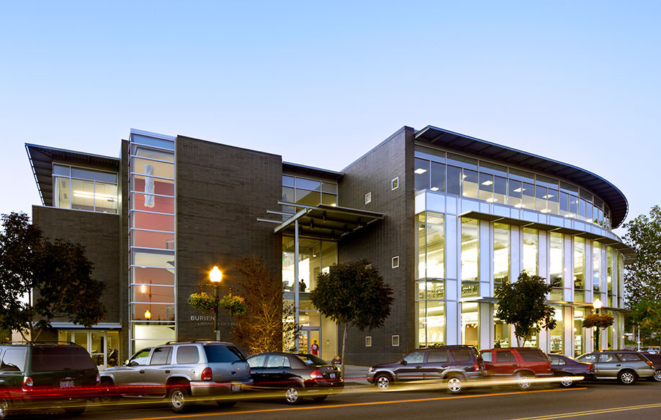
OWNER EXPERIENCE
Tukwila City Staff
David Cline, City Administrator
25 years local government experience.
6 years, City of Tukwila, City Administrator.
5 years, City Manager/Assistant City Manager, City of Burien.
Member International City Management Association.
Past President, Washington City Management Association.
Burien City Hall & Library
Project | Value | Role / Tasks | Completed
Burien City Hall & Library (GC/CM) | $38M | Owner | 2012
Tukwila Fire Stations Replacement (GC/CM) | $32M | Owner | In Progress

Slide 13
OWNER EXPERIENCE
Tukwila City Staff
Rachel Bianchi, Public Safety Plan Manager
Employed by the City of Tukwila for three years.
Has been involved in all aspects of Public Safety Plan implementation, incl. GC/CM process for three fire stations.
Oversees communications and government relations for the City.
Project | Value | Role / Tasks | Completed
Tukwila Fire Stations Replacement (GC/CM) | $32M | Owner | In Progress
Robin Tischmak, Acting Public Works Director & City Engineer
Employed by the City of Tukwila for 26 years.
Oversees 64 employees in operations, maintenance, engineering, administration.
Registered Professional Civil Engineer in the State of Washington.
Project management skills in design, engineering, bidding, construction.
Project | Value | Role / Tasks | Completed
Interurban Ave S Improvements (DBB) | $12M | City Engineer | July 2016
Tukwila Urban Center Pedestrian Bridge (DBB) | $10.7M | City Engineer | Current
Boeing Access Road Bridge Rehabilitation (DBB) | $12M | City Engineer | Current
Strander Blvd Extension Ph. 111 (DBB) | $39M | City Engineer | Current
Southcenter Parkway Extension (DBB) | $35M | City Engineer | Summer 2011
Urban Center Access (DBB) | $24M | City Engineer | 2010

Slide 14
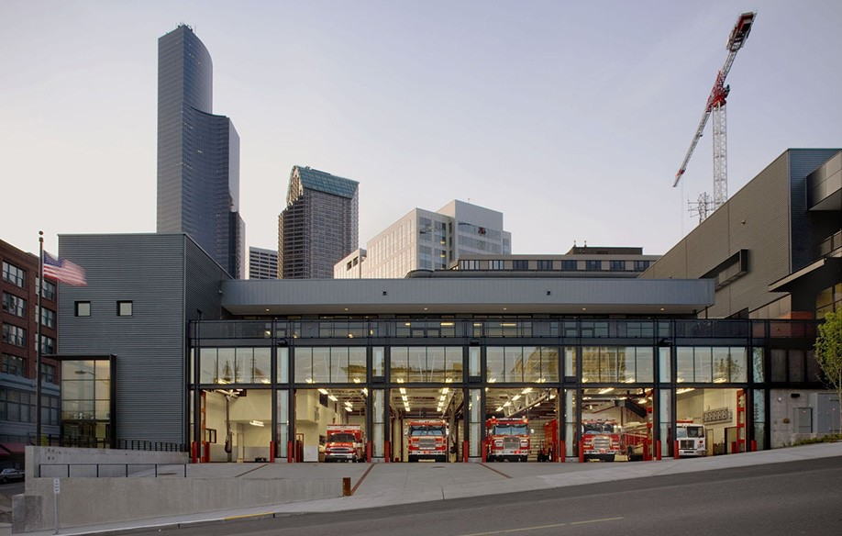
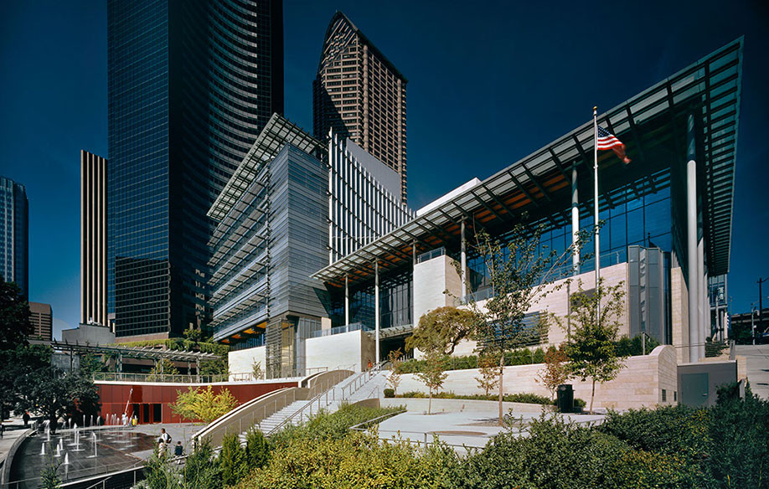
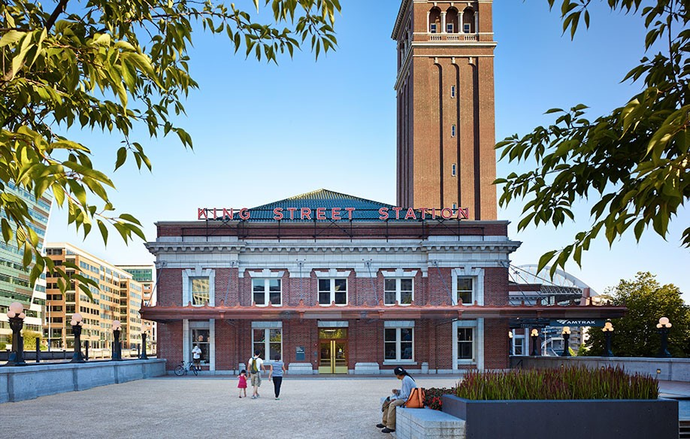
PROJECT MANAGER EXPERIENCE
Shiels Obletz Johnsen
Project Manager
GC/CM Projects:
Seattle Fire Station 10 (JK)
Burien City Hall & Library (JK)
Cascadia ES & Robert Eagle Staff MS (JK, EB)
Olympic Hills Elementary School (EB)
Bagley Elementary School (JK)
Pike Place MarketFront (JK)
ShoWare Events Center (EB)
King Street Station Rehabilitation (JK)
East County Courts
Safeco Field
Seattle Justice Center
Seattle City Hall & Plaza
MercyCorps Headquarters
Portland Streetcar Loop
Seattle Streetcar – South Lake Union
Portland Streetcar – Ph 1, 2, 3
Seattle Streetcar – First Hill
Seattle Fire Station 10
Seattle City Hall & Plaza
King Street Station Rehabilitation
JK = Justine Kim’s projects
EB = Ethan Bernau’s projects

Slide 15
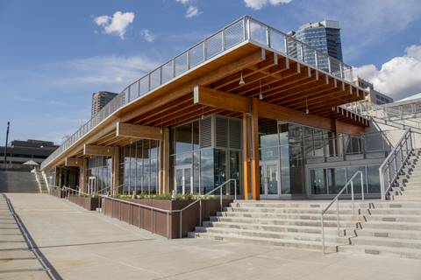
PROJECT MANAGER EXPERIENCE
Shiels Obletz Johnsen
Justine Kim, Program Manager/ Senior Project Manager
Licensed Architect in WA.
29 years experience in design, project and construction management.
Manages development, planning, programming, procurement, design, bidding, construction, commissioning, controls, compliance, contract development and dispute resolution.
GC/CM Projects: 6
MarketFront at Pike Place Market
Project | Value | Role / Tasks | Completed
Tukwila Fire Stations Replacement (GC/CM) | $32M | Program Manager | In Progress
Cascadia ES & Robert Eagle Staff MS (GC/CM) | $116M | Project Manager | 2017
MarketFront at Pike Place Market (GC/CM) | $74M | Project Manager | 2017
Burien City Hall & Library (GC/CM) | $38M | Project Manager | 2012
King Street Station Rehabilitation (GC/CM) | $55M | Project Manager | 2013
Seattle Fire Station 10 EOC and FAC (GC/CM) | $55M | Project Manager | 2009

Slide 16
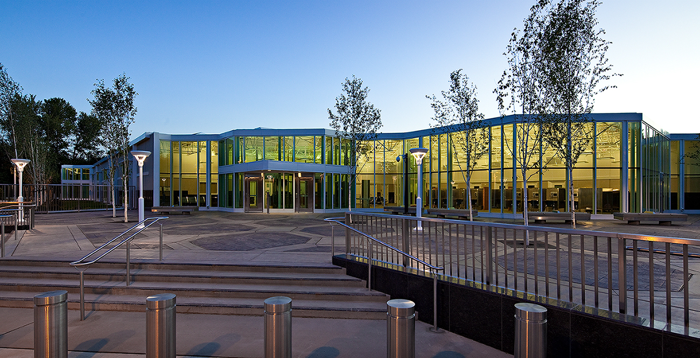
PROJECT MANAGER EXPERIENCE
Shiels Obletz Johnsen
Ethan Bernau, Project Manager
13 years experience as project manager and owner’s representative.
Responsible for procurement, contracting and management of GC/CM, Architect and consultants, change order review and negotiation, environmental review/ permitting, utility coordination, scheduling, and budgeting.
GC/CM Projects: 3
SCORE Correctional Facility
Project | Value | Role / Tasks | Completed
Cascadia ES & Robert Eagle Staff MS (GC/CM) | $116M | Deputy Project Manager / Construction Manager | 2017
Olympic Hills Elementary School (GC/CM) | $45M | Project Manager / Construction Manager | 2017
Seattle Central Waterfront Program | $300M+ | Project Manager / Project Coordinator | 2015
SCORE Correctional Facility | $97M | Deputy Project Manager | 2011
ShoWare Center (GC/CM) | $84M | Deputy Project Manager | 2009
Seattle Joint Training Facility | $33M | Project Coordinator | 2007

Slide 17
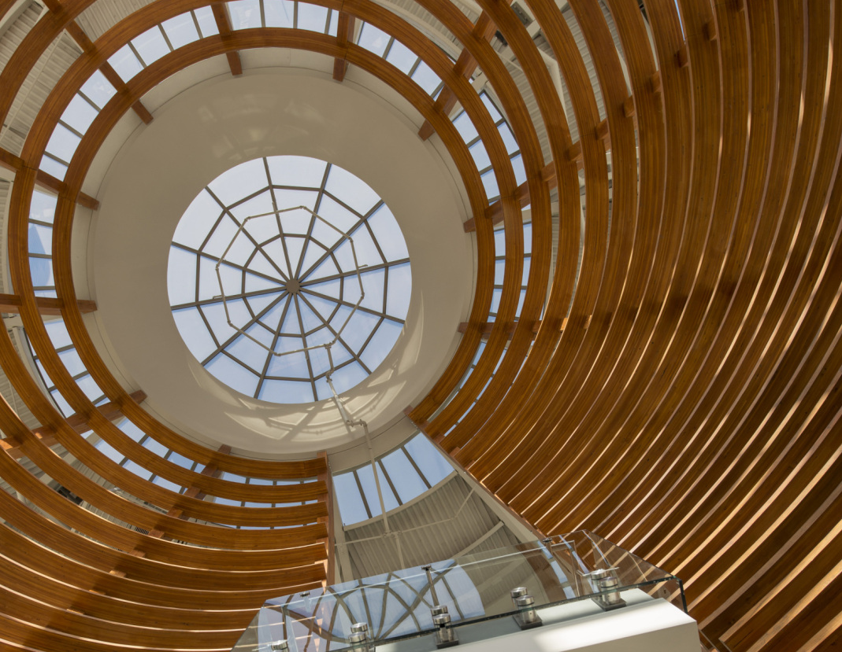
ARCHITECT EXPERIENCE
DLR Group
Bill Valdez, Principal in Charge
Licensed Engineer in Washington and Colorado.
22 years of experience on similar Justice+Civic project types.
Courts Expert with 18 years of experience at DLR Group.
GC/CM Projects: 20
Pueblo County Courthouse
Project | Value | Role / Tasks | Completed
Pueblo County Courthouse (CM/GC) | $54.8 M | Principal in Charge/PM | 2012
El Paso County Terry R Harris Judicial Complex Addition (CM/GC) | $41.1M | Project Manager | 2006
Wyoming Medium Correctional Institution (CM/GC) | $108.2M | Project Manager | 2008
Jefferson County Courts (CM/GC) | $11.6M | Principal in Charge | 2016
The Portland Building (Progressive DB) | $120M * | Principal in Charge | Current
76 Space Control & RAIDRS (DB) | $28.2M | Project Manager | 2008 & 2013
Fort Carson Warrior in Transition Facilities (DB) | $18.6M | Principal in Charge | 2012

Slide 18
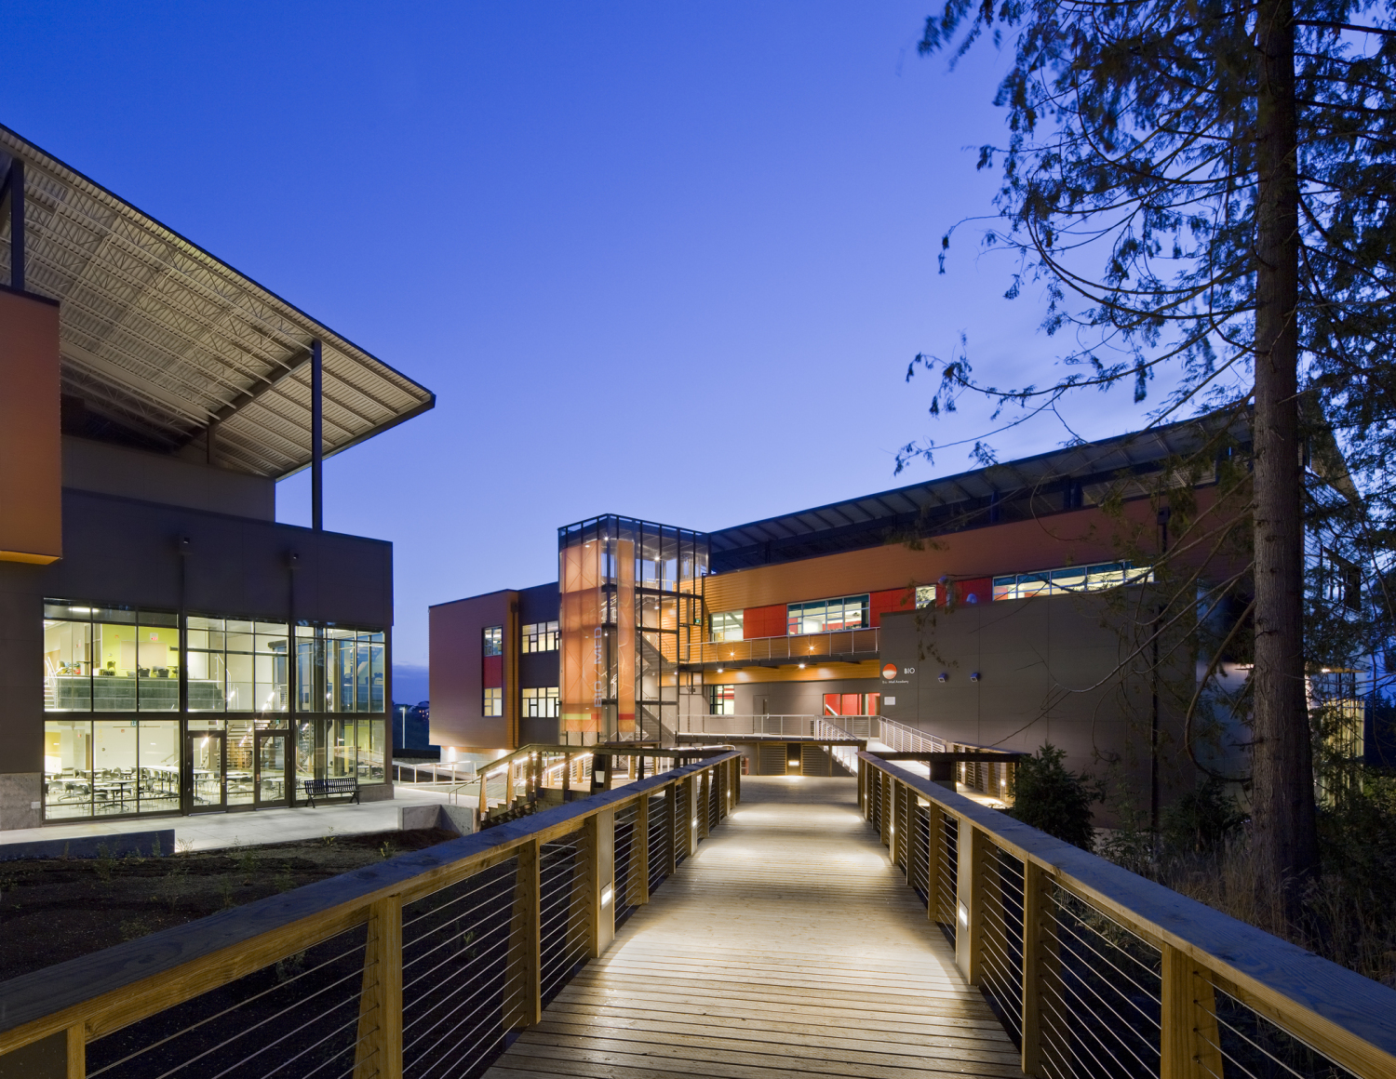
ARCHITECT EXPERIENCE
DLR Group
Erica Loynd, Project Manager
Licensed Architect in WA, OR, HI.
WELL Accredited Professional & LEED Accredited Professional.
15 years experience on similar Justice + Civic project types.
14 years experience at DLR Group.
AIA Academy of Justice National Leadership Group Member.
GC/CM Projects: 8
Marysville Getchell High School
Project | Value | Role / Tasks | Completed
Steilacoom High School (GC/CM) | $21.3M | Project Designer | 2008
Marysville Getchell High School (GC/CM) | $67.2 M | Project Designer | 2011
Bledsoe County Correctional Complex (GC/CM) | $143.4M | Project Architect | 2011
King County Children and Family Justice Center (DB) | $160M | Owner Technical Reviewer | Current
Glasgow School District, 4 school prototype | 50M GBP | Project Designer | 2007
North Glasgow College | 27M GBP | Project Designer | 2009

Slide 19
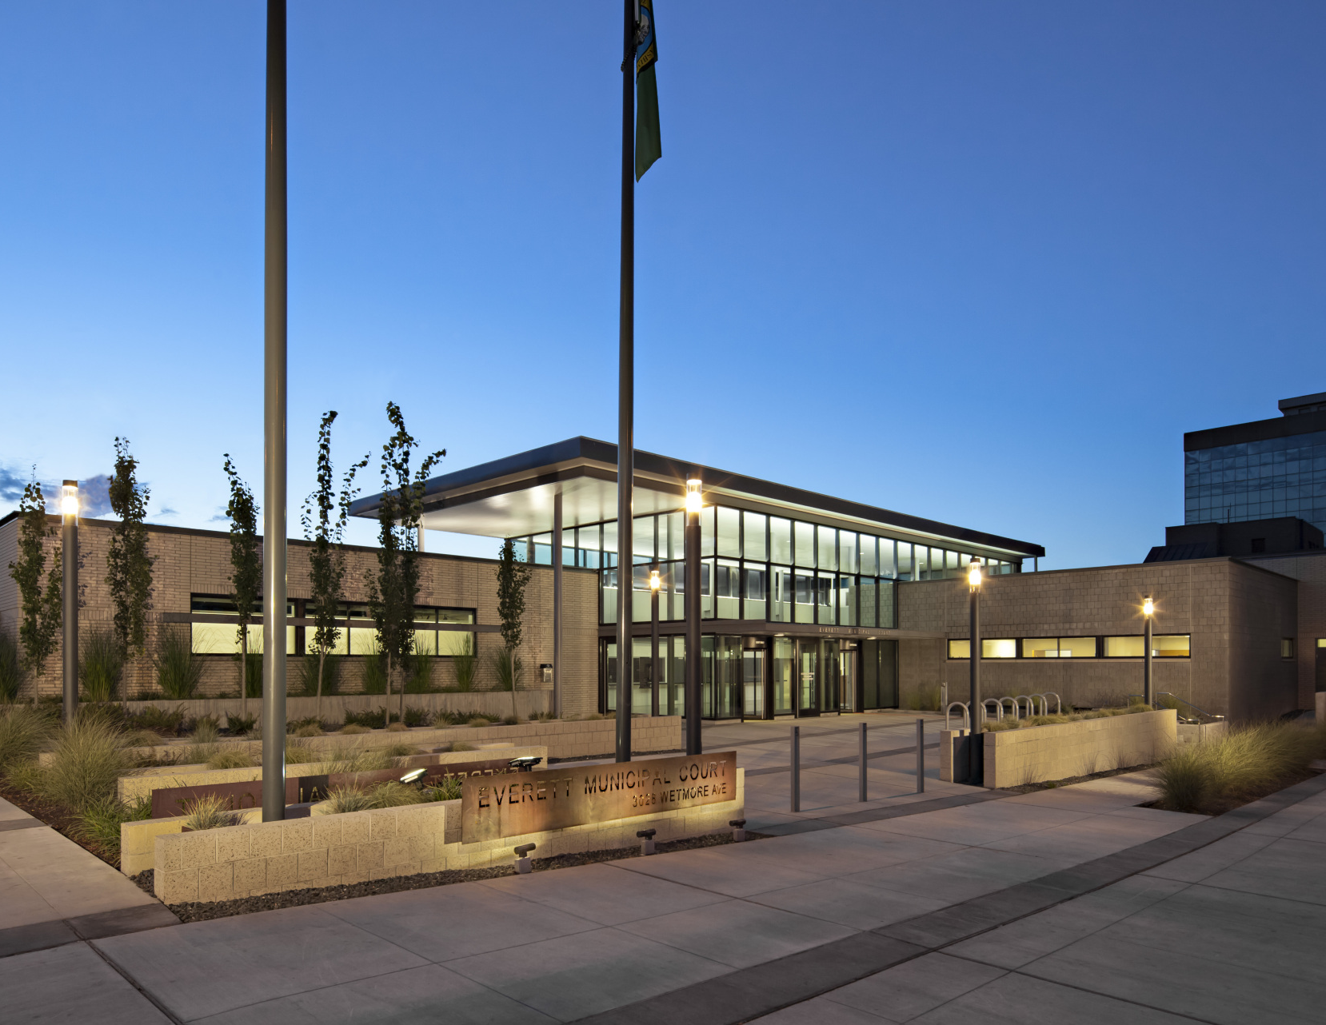
ARCHITECT EXPERIENCE
Everett Municipal Court
Everett, WA
Owner: City of Everett
Size: 25,000 sf
Completed: 2013
Project Delivery: Design-Bid-Build
Final Construction Cost: $5.8m
LEED Silver
Civic Design Award - AIA Washington Council - 2015
IES Illumination Award of Merit - Energy and Environmental Design Award Category - 2014
The new Everett Municipal Court revitalizes the image of city government in Everett. DLR Group’s design celebrates the Northwest and honors the unique history and culture of the City of Everett while retaining a consistent visual identity with an existing civic campus.
The new Everett Court facility is conceptualized as the gateway to the city campus, with a public courtyard serving as a primary feature for encouraging public connection to the function of the courts. A glass entry lobby serves as the feature design element, establishing the civic nature of the building and setting itself apart from other commercial buildings in the area. Creating greater range of vision through a focus on transparency within the building successfully merges the requirements for safety with the overall design philosophy.

Slide 20
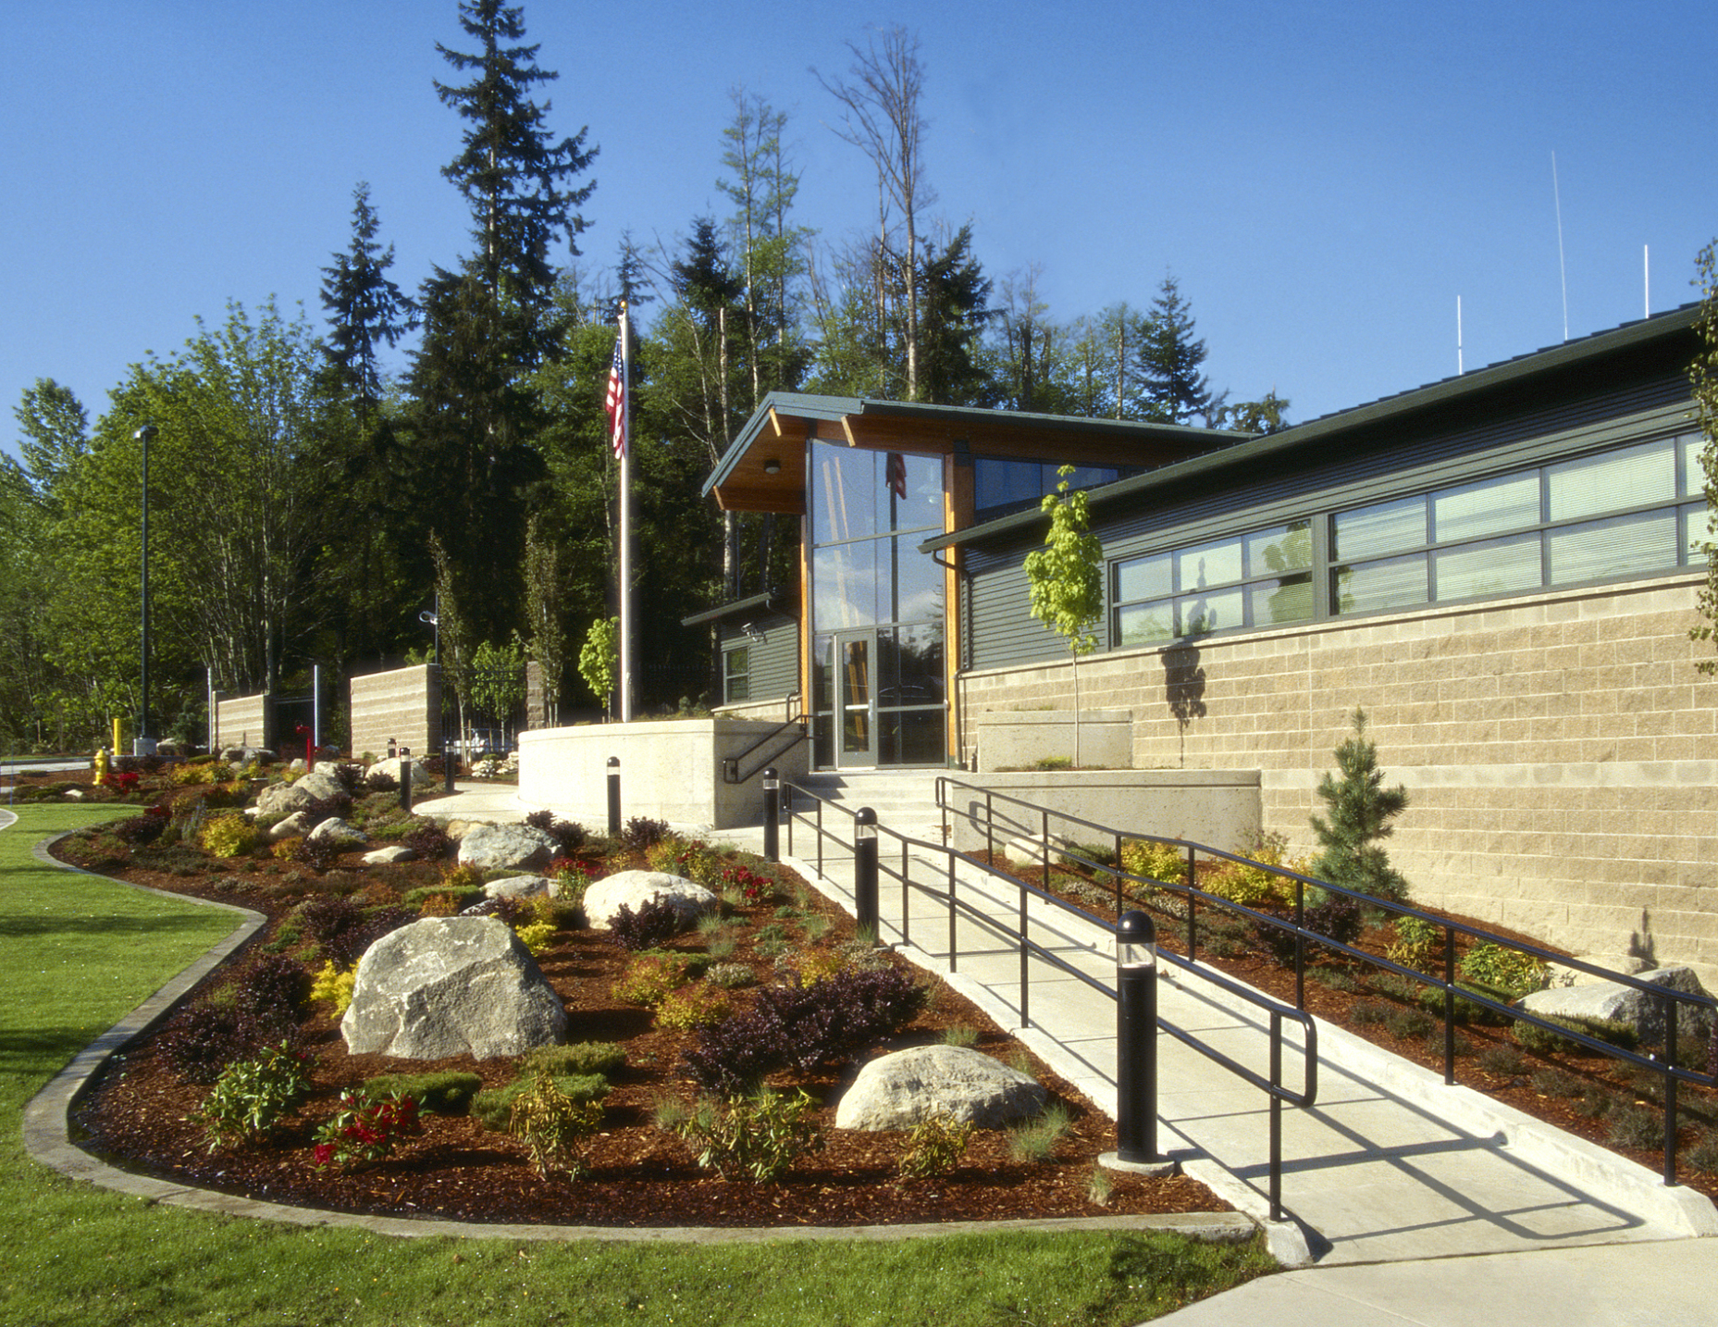
ARCHITECT EXPERIENCE
Mukilteo Police Station
Mukilteo, WA
Owner: City of Mukilteo
Size: 13,900 sf
Completed: 2003
Project Delivery: Design-Bid-Build
Final Construction Cost: $4.1m
The Mukilteo Police Station presents an approachable, inviting image that integrates well with the surrounding buildings and residential community. DLR Group’s design works within the site contours and keeps as many of the existing trees as possible to preserve the site’s natural amenities while the orientation and design allows the building to appear to grow naturally from the landscape.
The building’s architecture has created an inviting approach, complementing the nearby school, fire station, and residences through the use of earthy, area-appropriate materials such as CMU split-face block, metal siding, roofing, and glass. Visitors are welcomed immediately into a semi-public zone for direct interaction with the department. Based on population projections, the designed building orientation allows for a planned future expansion. Outdoor spaces feature vehicular circulation as well as public and private parking.

Slide 21
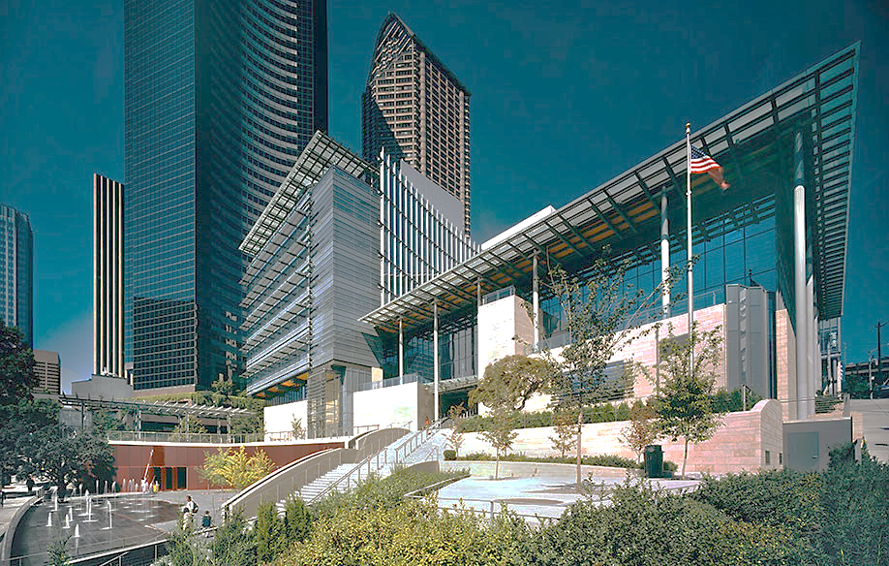
PROGRAM MANAGEMENT CONSULTANT
Steve Goldblatt
Tukwila City Council’s Program Management Quality Assurance Consultant
30 years of Washington public works experience at the policy, program, and project level
Member of the working group that drafted HB 2607 in 1994, creating RCW 39.10
Served as DRB chair, DRB member or sole neutral on 64 WA GC/CM projects from $15 million to $500 million
GC/CM Projects: 64
Seattle City Hall & Plaza
Project | Role / Tasks | Completed
UW Seattle Bill & Melinda Gates Center for Computer Science & Engineering | DRB Chair | Current
UW Seattle Fluke Hall Renovation | DRB Chair | 2017
City of Seattle Fire Station 10 | DRB Chair
City of Seattle Justice Center | DRB Chair
City of Seattle City Hall | DRB Chair

Slide 22
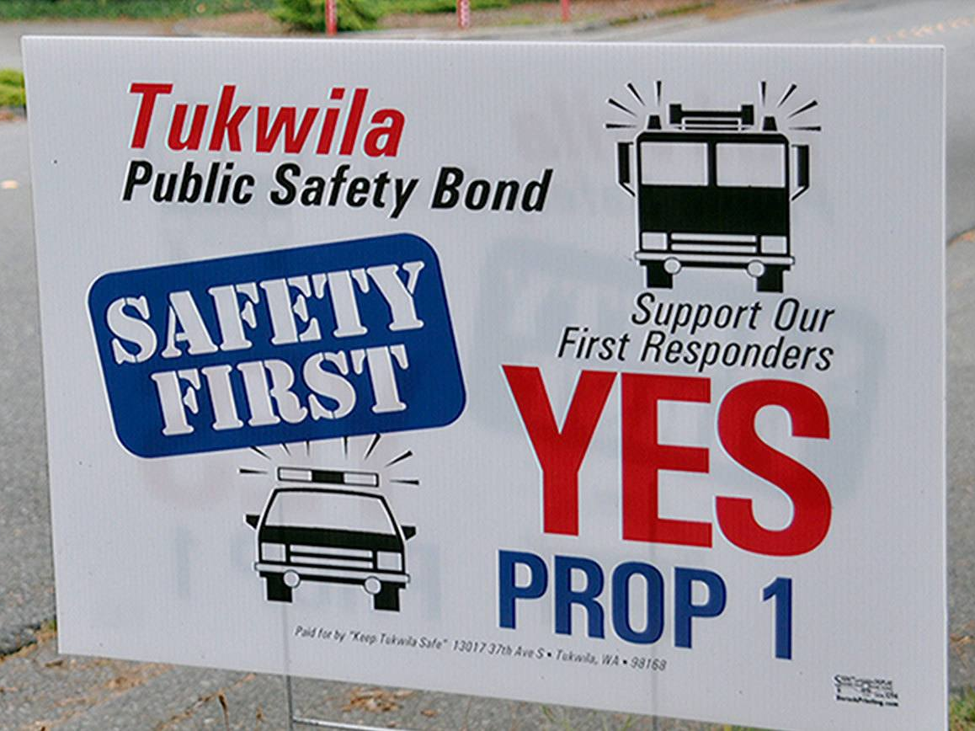
SUMMARY
Tukwila Justice Center Project
Significant project for the City of Tukwila
Tukwila has a long history of building successful capital projects
Meets RCW 39.10 criteria for GC/CM
Team has very strong GC/CM experience and record

