Slide 1
Rock Island Dam Powerhouse #2
Unit Motor Control Centers (MCCs) Replacement
Application to use the Progressive D/B Delivery Method
March 25, 2021 Presentation
“To provide sustainable, reliable utility services that enhance the quality
of life in Chelan County.”
Notes:
Jim Dugan to introduce Project and presentation participants

Slide 2
Agenda
Introductions
Chelan County PUD
The Project
Project Budget
Project Schedule
Why Progressive Design-Build
Qualifications
Organization Chart
Summary
Notes:
JD

Slide 3

Introductions
Notes:
JD

Slide 4
The Project Team – Here Today
Chelan County Public Utility District No. 1
John Sagerser, Rock Island EPM Manager
Devin Myers, Rock Island Project Manager
Salim Qazi, Rock Island Project Manager
Parametrix
Jim Dugan, D/B Program Advisor
Dan Cody, D/B Procurement & D/B PM/CM Support
Maggie Anderson, Project Controls Specialist
Notes:
JD

Slide 5
The Project Team:
Other Team Members
Chelan County Public Utilities District No. 1
Steve Wright, General Manager
Justin Erickson, Managing Director - District Services
Sam Nott, Lead Electrical Engineer
Adam Couey, Electrical Engineer
Katie Yount, Internal Legal Counsel
Chuck Boss, Construction Manager
Perkins Coie
Graehm Wallace, D/B Legal Advisor
Hydro Design Consultant
Stantec Consulting
Notes:
JD

Slide 6
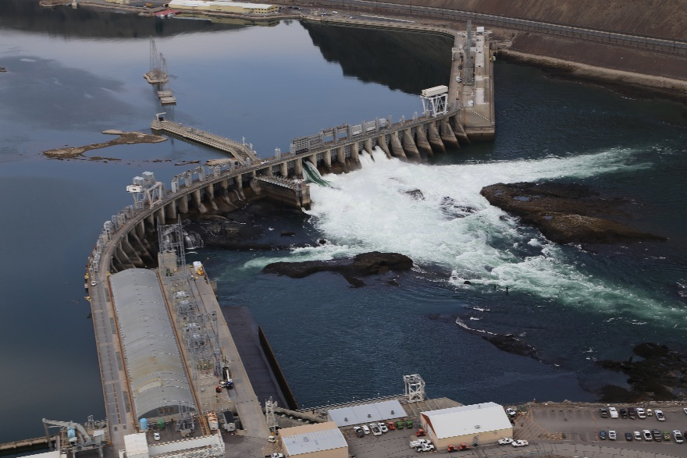
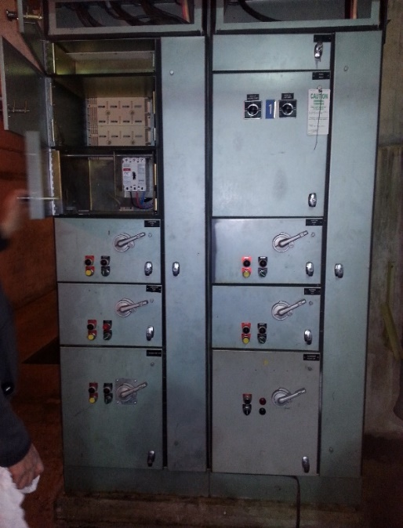
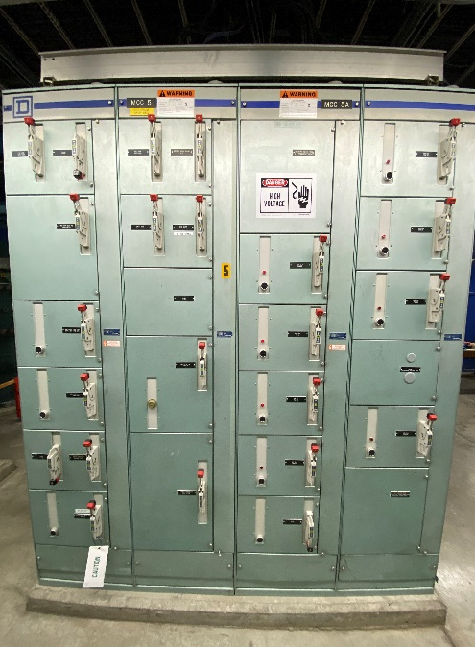
Chelan County PUD
Notes:
John Sagerser present the District information

Slide 7
The District
Chelan County PUD was established in 1936
Second largest, non-federal, publicly owned hydro generation capacity in the U.S.
800 Employees
50,000 Customers
3,000 sq. mile service territory
Approximately 2,000 megawatts of generating capacity
35% of hydropower generated serves county residents, the remainder is sold through contracts and into the energy market.
Three Hydroelectric projects
  Lake Chelan Dam –Built in 1927
  Rock Island Dam – First Powerhouse built in 1933,
                Second Powerhouse built in 1979
  Rocky Reach Dam – Built in 1961
Operate
  Water/wastewater – approx. 5,000 customers
  Fiber & telecom – 13,000 customers
  Parks & recreation – 14 parks along the Columbia River and Lake Chelan
Notes:
JS

Slide 8

The Project
Notes:
JS

Slide 9
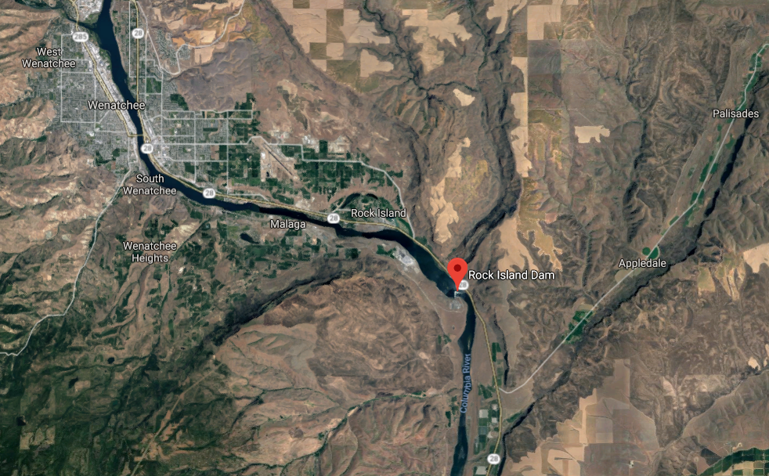
Rock Island Dam
Notes:
JS

Slide 10
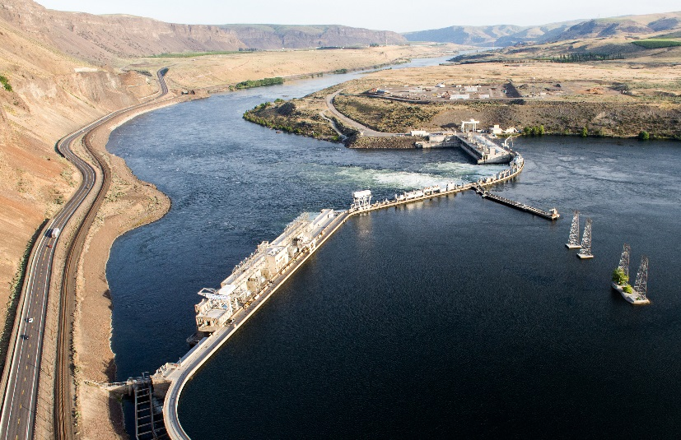
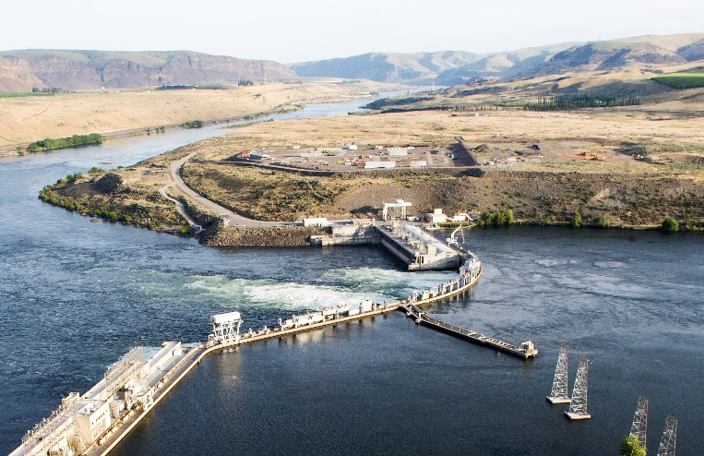
Rock Island Dam
First Powerhouse built in 1933
First Hydropower project on the Columbia River
Second Powerhouse built in 1979
Last Hydropower project on the Columbia River
Eight (8) original turbine-generator units installed in Powerhouse #2
Turbine-generators and associated Balance of Plant systems have exceeded their 40-year useful life
Unit Motor Control Center Replacement will help ensure another 40 years of reliable/efficient operation
Replacements will be scheduled in conjunction with Unit rehabilitation outages to minimize disruption to power generation capability
Notes:
JS

Slide 11
Rock Island Dam
Unit Motor Control Centers (MCC’s) Replacement
Removal of existing unit MCCs, governor MCCs, and draft tube gate MCCs.
New MCCs to have arc flash risk mitigation design and safety features.
New cabling and cable trays to new MCCs if needed for feeds and loads.
MCC to be designed for seismic requirements.
MCC cabinets designed for location/service conditions.
Scheduling to be coordinated with District generator refurbishment outages.
Notes:
Devin Myers to present Project specific information
Removal and Replacing Unit Motor Control Centers
A motor control center (MCC) is equipment used to control electric motors in a central location. It consists of multiple enclosed sections, or Buckets, having a common power bus.
MCC Buckets are made up of components like motor starters, relays, variable frequency drives, Programable Logic Controls (PLC’s) and other components that control motor-based equipment (i.e. Cooling Fans or Unwatering/Governor Pumps Motors).

Slide 12
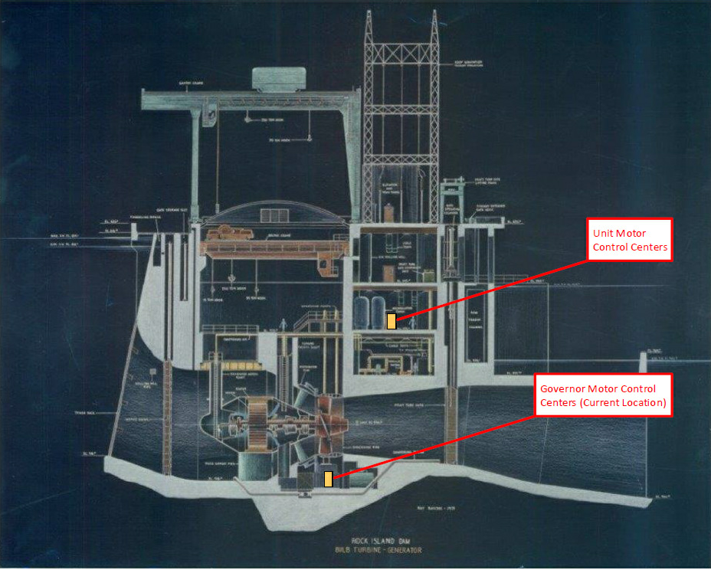
Notes:
DM
MCC locations
Unit MCC are located on the (573’)
Governor MCC’s are located on the (504’) and are subject to a wet environment.

Slide 13
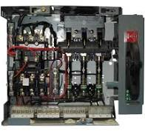
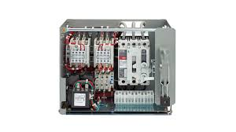
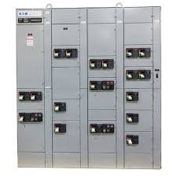
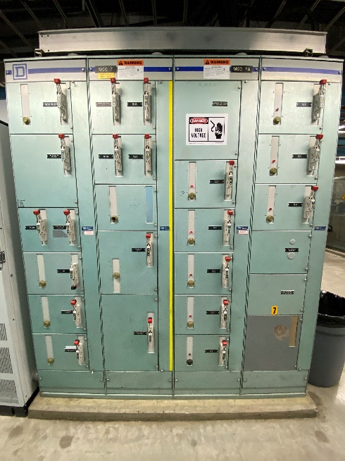
Rock Island Dam Powerhouse #2
Motor Control Center Replacement Project
Motor Control Center Installation
Notes:
DM
Cable Bus Make up
Top rt. – Old Style
Top lt. – New Style
Bottom rt. – Old Style Panel
Bottom Lt – New Style Panel

Slide 14
Rock Island Dam Powerhouse #2
Unit Motor Control Center Replacement Project Budget
Category | Budget
Costs for Professional Services (A/E, Legal, etc.) | $ 130,000
New Arc Flash Resistant Motor Control Centers | $ 1,600,000
Installation construction costs | $ 1,025,000
Materials (Cable and Cable Tray) | $ 575,000
District Administration and Project Management | $ 145,000
Total | $ 3,475,000
Note: All design and construction costs identified above include 8.2% sales tax and a combined 20% contingency that includes 5% for State requirement and 15% for design, construction, escalation, and inflation.
Notes:
DM
Project Budget
Budget estimated at $3.5mil
All costs include 8.3% sales tax, 5% owners project contingency and a combined 15% contingency for design, construction, escalation and inflation

Slide 15
Project Funding
  Project funding was approved by the District Board of Commissioners in November 2017
  District currently plans to fund project with cash reserves until 2022
  District plans to issue bonds for funding beyond 2022
  District’s current bond rating is AA+/Stable, one of the top five public utilities
Notes:
DM –Project Funding
This project is part of the PH2 Rehabilitation Program
Funding for this Program was INITIALLY approved by the District Board of Commissioners in 2017
And continues to be supported in the subsequent Capital Budgets

Slide 16
Rock Island Dam Powerhouse #2 Unit Motor Control Center Replacement Project D/B Schedule
Project Schedule | Estimated Date
PRC Presentation | March 25,2021
Publication of RFQ for Design/Build Services | March 30, 2021
Project Information Meeting (Date subject to change.) | April 12, 2021
RFQ Submittal Deadline | May 6, 2021
Open & Review/Score Submittals Received | May 7-13, 2021
Identify Finalists & Issue RFP & Proprietary Meeting Notifications | May 14, 2021
Proprietary Meeting #1 | June 21-25, 2021
Proprietary Meeting #2 (if required) | July 12-16, 2021
RFP Submittal Deadline (Proposals & Cost Factors) | August 6, 2021
Open & Review Proposals (Cost Factors not reviewed) | August 9-16, 2021
Open Cost Factors & Score Proposals | August 17, 2021
Design/Builder Interviews | August 23-27, 2021
Notify Design/Builders of Scoring and Most-Qualified Design/Builder | September 2, 2021
Notes:
DM
Project Schedule
We plan to issue the RFQ early next month (Next week or as soon after as possible)
Identify qualified Design-Builders to move into the RFP stage by mid-May
Notify the Most-Qualified Design/Builder in September

Slide 17
Rock Island Dam Powerhouse #2 Unit Motor Control Center Replacement Project D/B Schedule
Project Schedule | Estimated Date
Design/Build Contract Negotiation | September 9-30, 2021
Execute Design/Build Agreement with Preconstruction Phase | October 2021
Preconstruction Phase/GMP Negotiation | October 2021-November 2021
GMP Amendment Executed | December 2021
Manufacturing – First Unit and Unit Common | December 2021 – March 2022
Site Set-up and Mobilization | April 2022– May 2022
Construction Phase | June 2022 – August 2030
Notes:
DM
Project Schedule (cont.)
Execute D/B Agreement in October 2021
Execute GMP in December 2021
Construction Phase 2022 – 2030

Slide 18
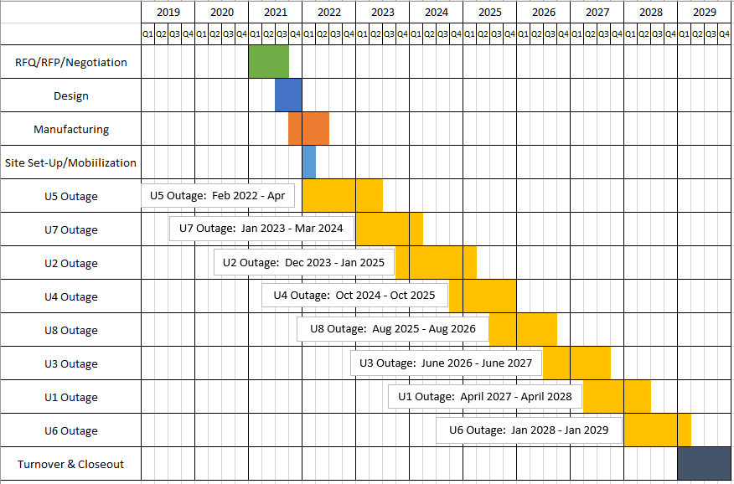
Rock Island Dam Powerhouse #2 Unit Motor Control Center Replacement Project Development Schedules
Critical Phasing
Notes:
DM
Project Schedule (cont.)
Execution to be performed in conjunction with our PH2 Unit Rehabilitation Schedule

Slide 19
Why D/B Delivery Method for Rock Island Dam Powerhouse #2 Unit Motor Control Center Replacement Project
Notes:
DM
Why B/D
Gives us the opportunity explore innovative technology and execution solutions
PH2 is a functioning power generation facility and having the ability to work with the most qualified Design/Builder will be crucial to completing this project without causing major disruption to Operations

Slide 20
RCW 39.10 D/B Statutory Compliance
(5.1) If the construction activities are highly specialized and a D/B approach is critical in developing the construction methodology
  Rock Island Powerhouse 2 is considered critical infrastructure.
  “Bulb” turbine-generator are rare in the U.S.
  Powerhouse 2 is an operating power plant. Phased construction required to minimize operational impacts on power generation
  Limited access for removal and reinstallation
  The existing governor MCCs are in a wet environment so specialized design-build approach is needed to determine whether the MCC should be relocated or re-designed to meet the wet conditions
Notes:
DM
Statutory Compliance
This project meets the Statutory requirements by:
Powerhouse 2 is continually operating power plant.
Phased construction required to minimize operational impacts on power generation
This being highly specialized work (Cable - Size and Routing)
Several new technologies have been developed since original installation (Networking & Arc Flash)
Innovative installation procedures and scheduling options could bring cost and time savings to this project.

Slide 21
RCW 39.10 D/B Statutory Compliance (Cont.)
(5.2) If the project provides opportunity for greater innovation and efficiencies between the designer and builder
  The new MCCs are to have arc flash mitigation which each manufacturer has unique solutions
  Design Build will allow the contractor to propose an innovative network control solution that meets the District’s operations and maintenance requirements
  Proprietary design solutions can be leveraged to achieve the most suitable design, supply, and installation for the project components
  Design may vary based on specific condition and needs of each unit
  Owner does not have expertise to specify options for improvement to existing systems
(5.3) If significant savings in project delivery time would be realized
  It will be imperative that the contractor is involved in scheduling, coordination and phasing of the work
  Scheduling and installation innovation can reduce the installation time and multiple contractor coordination
Notes:
DM
Statutory Compliance
This project meets the Statutory requirements by:
Powerhouse 2 is continually operating power plant.
Phased construction required to minimize operational impacts on power generation
This being highly specialized work (Cable - Size and Routing)
Several new technologies have been developed since original installation
Innovative installation procedures and scheduling options could bring cost and time savings to this project.

Slide 22
Public Body Qualifications
Notes:
JS

Slide 23
CCPUD Leadership Team
CCPUD has extensive construction experience including projects of similar scope and complexity
  Long history of projects delivered using Design-Bid-Build or Negotiated Contract.
  Long track record of building projects on-time and within budget.
  CCPUD is currently using Progressive Design-Build for:
    RI PH2 Generator and Turbine Rehabilitation
    Draft Tube Gate Refurbishment
    Main Generator Lead Replacement
  CCPUD is currently using GC/CM for two facilities projects.
CCPUD team members have attended the AGC Design-Build Workshop
CCPUD team members have attended the DBIA Certification Workshop
CCPUD has two team members that are Assoc. DBIA certified
Parametrix: Dan Cody D/B PM Support and Jim Dugan Internal D/B Advisor
Graehm Wallace, (Perkins Coie): External D/B Legal Counsel
CCPUD satisfies the public body qualifications by staff augmentation with consultants.
Notes:
JS

Slide 24
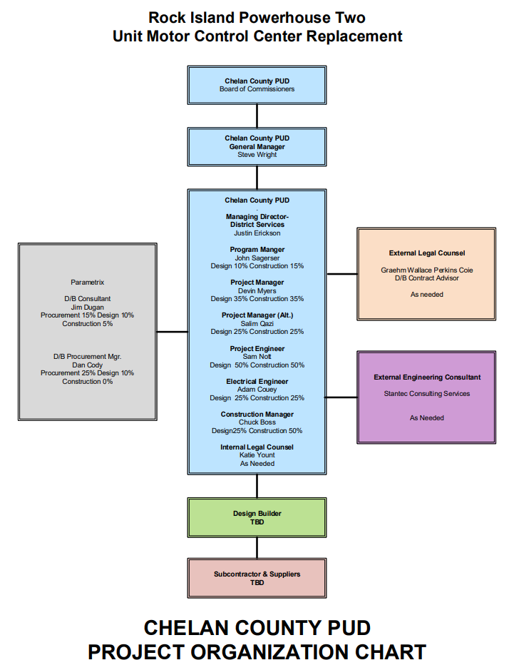
Rock Island Dam Powerhouse #2 – Unit Motor Control Center Replacement
Project Organizational Chart
Notes:
JS

Slide 25
Rock Island Dam Powerhouse #2 – Main Generator Leads Replacement
Project Organizational Chart
Project Team Member | Rock Island Powerhouse Two Unit Motor Control Center Replacement |  | Other Duties
 | Procurement & Design | Construction
District Project Team
John Sagerser – Program Manager | 10% | 10% | 80%
Devin Myers – Project Manager | 35% | 35% | 65%
Salim Qazi – Project Manager (Alt.) | 25% | 25% | 75%
Sam Nott – Project Engineer | 50% | 50% | 50%
Adam Couey – Electrical Engineer | 25% | 25% | 75%
Chuck Boss – Construction Manager | 25% | 50% | 50%
Katie Yount – Internal Legal Counsel | As Needed | As Needed
Consultant Project Team
Jim Dugan – D/B Consultant | 15% | 5%
Dan Cody – D/B Procurement Mgr. | 25% | 0%
Graehm Wallace – External Legal Counsel | As Needed | As Needed
(Stantec) – External Engineering Consultant | As Needed | As Needed
Chelan PUD Organizational Structure:
The District is currently in the process of rehabilitating powerhouse two at Rock Island Dam. This project is a balance of plant project that will be executed as part of the full powerhouse rehabilitation project. Through the DB procurement process, we will secure contracts with experienced teams of Contractors that will need limited support and oversight from the project team during the execution phase of this project. The District does, however have a deep bench including internal personnel in addition to Service Agreements for engineering and project administrative personnel if needed.
Notes:
DM or JS

Slide 26
Project Team D/B Experience
Notes:
JS

Slide 27
Name | Experience
John Sagerser Rock Island EPM Manager Chelan County PUD | 28 yrs. Electrical Engineering/Project Management Experience 17 yrs. Hydro Engineering/Project Management Experience Project Manager for Lake Chelan Hydro Modernization ($35M 2006 to 2010) Project Manager for Rock Island Powerhouse 1 Rehabilitation (2015 to 2018)
Devin Myers Rock Island Project Manager Chelan County PUD | 17 yrs. Hydroelectric Industry Maintenance Planning/Project Management RI PH2 Draft Tube Gate Refurbishment($4.4M 2016 to 2019) RI PH2 Storage Building (Initiation through Bidding) ($3.4M 2016-2017) RI PH2 Oil Handling System($650K 2016 to 2018)
Chuck Boss Construction Manager Chelan County PUD | 20 yrs. Industrial Engineering/Construction Management Experience 12 yrs. Hydro Construction Management/Quality Control Experience Construction Manager Rock Island Powerhouse 1 Rehabilitation QA/QC Representative Rock Island Powerhouse 1 Rehabilitation Construction Manager Rock Island Denil Installation/Removal
Jim Dugan D/B Program Advisor Parametrix | 42 yrs. Program/Project Management Projects: TPS – Boze Elementary School; TPS Hunt Middle School; Downing Elementary School; Skyline Elementary School; Fawcett Elementary School; Willapa Valley Elementary School Gym; Multiple large D/B projects worldwide with The Austin Company Project Review Committee Member: Term Ends June 2023
Notes:
JS

Slide 28
Name | Experience
Dan Cody D/B Procurement and PM Support Parametrix | 30 yrs. Of Design & PM/CM 4 D/B Projects: South Puget Sound Community College – Lacey Campus; Building #1; Tacoma Public Schools – Boze Elementary School; Tacoma Public Schools – Hunt Middle School; Willapa Elementary School Gym
Graehm Wallace Outside Legal Counsel Perkins Coie | Graehm has prepared Design-Build contract documents under RCW 39.10 for the Washington State School Directors Association, the Tacoma School District, and the Willapa Valley School District as well as Design-Build contract documents for dozens of private projects. Graehm has over twenty-two years legal counsel experience working in all areas of construction and has provided legal assistance to over 100 Washington public entities. His work has covered all aspects of contract drafting and negotiating. This includes preconstruction, architectural, engineering, construction-management, GC/CM, Design-Build and bidding. Graehm has also provided legal advice during construction, claim prosecution and defense work.
Notes:
JS

Slide 29
Summary
Project is funded with the appropriate budgets
Projects meet qualifying RCW criteria
Project Management Plan is developed and has clear and logical lines of authority
Project team has the necessary experience
Project team has the capacity
Project team is prepared and ready to proceed
Notes:
Jim Dugan

Slide 30
Thank you
Notes:
All

